Slide 1
Juniper Wi-Fi 6 Access Point Portfolio & Positioning
July, 2020

Slide 2
Juniper Wi-Fi 6 Access Point Portfolio
 | AP43 | AP63 | AP33 | AP32 | AP12
Deployment | Indoor | Outdoor | Indoor | Indoor | Indoor Wall Plate
Wi-Fi Standard | 802.11ax (Wi-Fi 6) 4x4:4SS | 802.11ax (Wi-Fi 6) 4x4:4SS | 802.11ax (Wi-Fi 6) 5GHz: 4x4:4SS 2.4GHz: 2x2:2SS | 802.11ax (Wi-Fi 6) 5GHz: 4x4:4SS 2.4GHz: 2x2:2SS | 802.11ax (Wi-Fi 6) 2x2:2SS
Wi-Fi Tri-Radio
Antenna Options | Internal External | Internal External | Internal | Internal External | Internal
Virtual BLE |  |  |  | --- | ---
IoT Interface |  | --- | --- | --- | ---
IoT Sensors | Humidity, Pressure, Temperature | --- | --- | --- | ---
Warranty | Limited Lifetime | One Year | Limited Lifetime | Limited Lifetime | Limited Lifetime
NEW
NEW
NEW
NEW

Slide 3
Juniper Wi-Fi 6 APs Driven by Mist AI
Wi-Fi 6 Standard Features
Mist AI Empowered Cloud Microservices
OFDMA – improves RF efficiency by centralizing scheduling
1024-QAM – improves data rate with 25% more efficiency
MU-MIMO - supports higher density with increased group size from 4-8 users
Target Wake Time (TWT) – reduces power usage and contention for IoT devices
BSS Coloring – adds spatial reuse for better efficiency in dense networks
Wi-Fi Assurance – enables a predicable, reliable and measurable Wi-Fi
Marvis Virtual Assistant – helps IT teams get to answers in real-time with automated operation
Premium Analytics- enables end-to-end network visibility with rich insights
User Engagement– Mist patented vBLE enables indoor location services with 1-3 meter accuracy
Asset Visibility– Gets full visibility into people and things using standard based BLE services

Slide 4
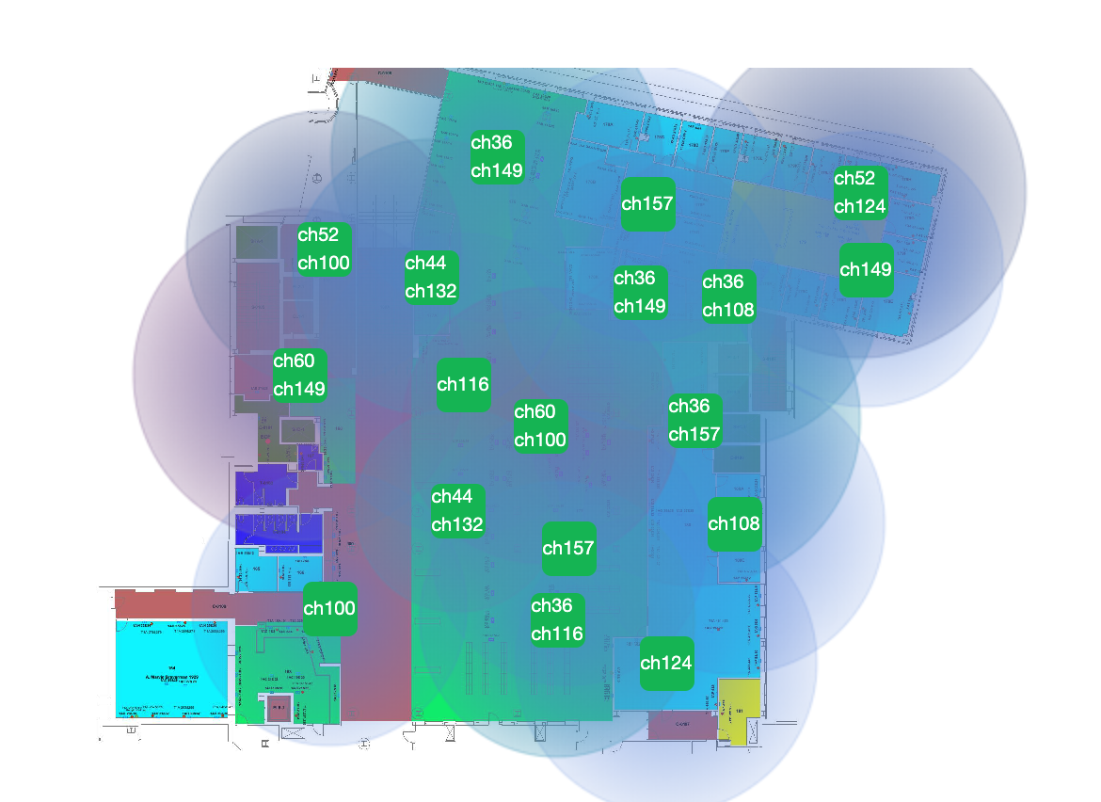
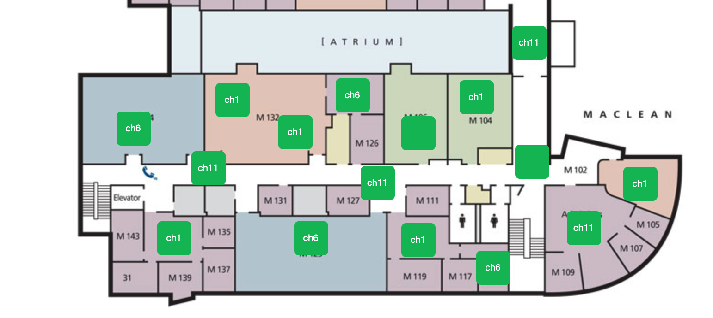
Continuing our RF Innovation: Automatic Band Selection
2.4 GHz -> Auto Cancellation
Dual 5 GHz -> Auto Conversion
Available on all AP models
Available on all AP43 and AP63

Slide 5
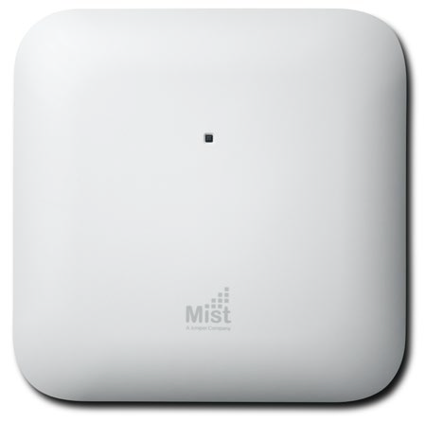
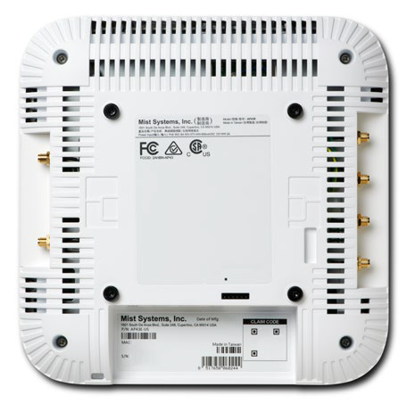
Juniper AP43 Access Point
802.11ax
One 4x4:4 2.4GHz radio: up to 1,148 Mbps data rate
One 4x4:4 5GHz radio: up to 2,400 Mbps data rate
Dual-band 3rd Radio (Security, Network and Location Sensing)
Internal and External Antenna Models
1
2
802.3bz Multi-Gigabit Ethernet
2.5Gbps PHY
802.3at PoE, 802.3bt PoE, 12V/3A DC power supply
The highest performance 802.11ax (Wi-Fi 6) Wi-Fi with Bluetooth® LE and IoT.
Turn by turn location services with 1 to 3 meter accuracy through Mist patented vBLE technology and open APIs.
Integrated IoT sensors and interface ports enable better visibility, improved location context, and support of IoT devices.
Managed by the Mist Cloud, it delivers unprecedented user experiences for high device density environments that often require mobile engaged location services.
3
Enterprise-Grade BLE Service
Bluetooth 5.0
vBLE 16-element Directional Antenna Array
Engagement and Asset Visibility
4
IoT Sensors, IoT Port, and USB Expansion Port
Humidity, Pressure, Temperature
Develop Ecosystem of IoT Devices and Solutions

Slide 6
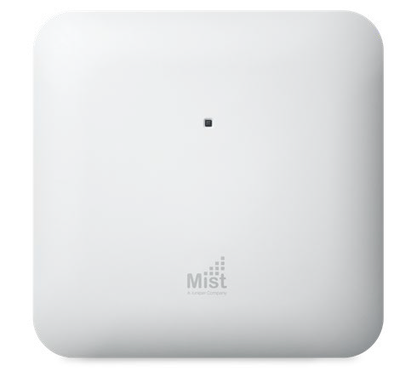
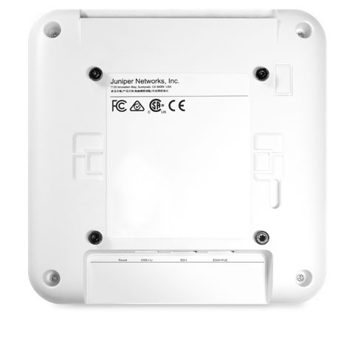
Juniper AP33 Access Point
NEW
802.11ax
One 2x2:2 2.4GHz radio: up to 575 Mbps data rate
One 4x4:4 5GHz radio: up to 2,400 Mbps data rate
Dual-band 3rd Radio (Security, Spectrum and Location Analytics)
Internal Antenna Model
1
2
802.3bz Multi-Gigabit Ethernet
2.5Gbps PHY
802.3at PoE, 802.3bt PoE
802.3af compatible
High performance Wi-Fi 6 AP with vBLE
Turn by turn location services with 1 to 3 meter accuracy through Mist patented vBLE technology and open APIs.
Dynamic network insights and automated operation.
Managed by the Mist Cloud, it delivers unprecedented user experiences for retail, warehouse, school, clinic and home office environments.
3
Enterprise-Grade BLE Service
Bluetooth 5.0
vBLE 16-element Directional Antenna Array
Engagement and Asset Visibility
4
USB Expansion Port
Develop Ecosystem of IoT Devices and Solutions

Slide 7
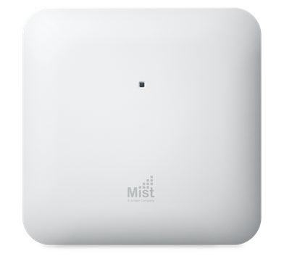
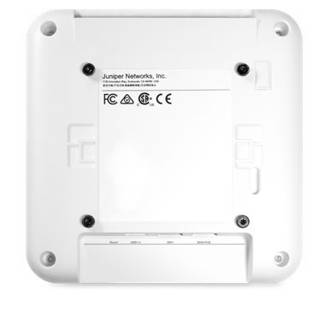
Juniper AP32(E) Access Point
802.11ax
One 2x2:2 2.4GHz radio: up to 575 Mbps data rate
One 4x4:4 5GHz radio: up to 2,400 Mbps data rate
Dual-band 3rd Radio (Security, Network and Location Sensing)
Internal and External Antenna Models
NEW
1
2
802.3bz Multi-Gigabit Ethernet
2.5Gbps PHY
802.3at PoE, 802.3bt PoE
802.3af compatible
High performance Wi-Fi 6 AP at a lower cost.
Asset visibility with super beacon capability.
Dynamic network insights and automated operation.
Managed by the Mist Cloud, it delivers unprecedented user experiences at a lower cost for retail, warehouse, school, clinic and home office environments.
3
Enterprise-Grade BLE Service
Bluetooth 5.0 : Omni Bluetooth Antenna
Asset Visibility
Super beacon capability
4
USB Expansion Port
Develop Ecosystem of IoT Devices and Solutions

Slide 8
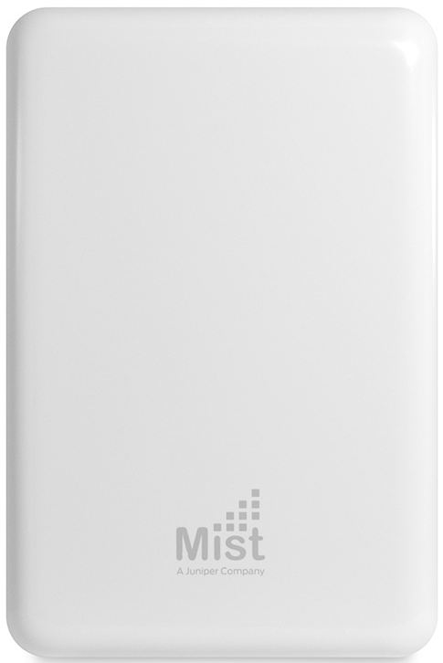
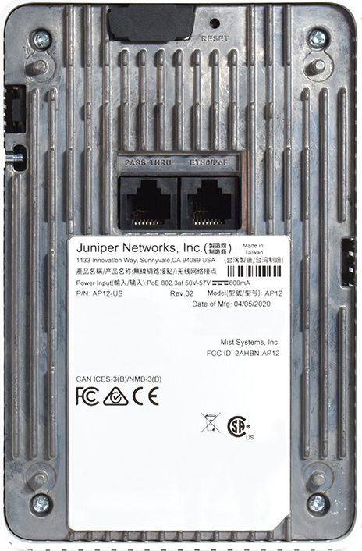
Juniper AP12 Access Point
NEW
802.11ax
One 2x2:2 2.4GHz radio: up to 575 Mbps data rate
One 2x2:2 5GHz radio: up to 1200 Mbps data rate
Dual-band 3rd Radio (Security, Network and Location Sensing)
Internal Antenna Models
1
2
Multiple device connections
802.3af/at PoE
5 Ethernet Ports
Wall plate Wi-Fi 6 AP with easy and flexible deployment.
Supports multiple IT and IoT devices simultaneously.
Asset visibility with super beacon capability.
Dynamic network insights and automated operation.
Managed by the Mist Cloud, it delivers the performance, flexibility, and services desired by home office, remote worker, school dorm, and hotel room, etc.
3
Enterprise-Grade BLE Service
Bluetooth 5.0 : Omni Bluetooth Antenna
Asset Visibility
Super beacon capability
4
Wall plate Mount
Flexible deployment

Slide 9
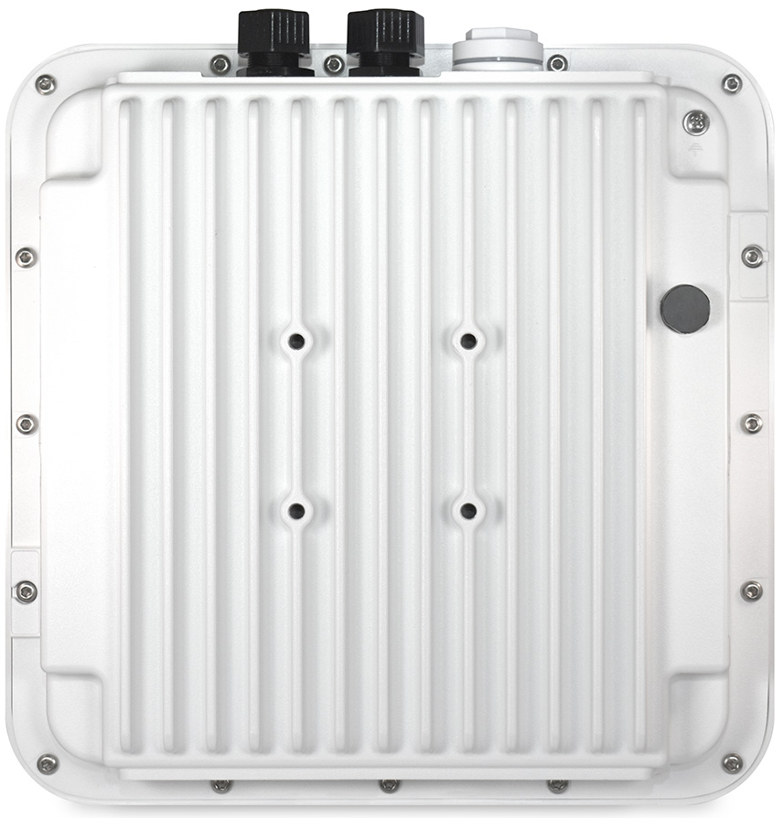
Juniper AP63(E) Outdoor Access Point
NEW
1
802.11ax
One 4x4:4 2.4GHz radio, up to 1,148 Mbps data rate
One 4x4:4 5GHz radio, up to 2,400 Mbps data rate
Dual-band 3rd Radio (Security, Spectrum and Location Sensing)
Internal and External Antenna Models
2
Operating Temp
-20° to 65° C; no solar loading
-20° to 55° C; with solar loading
High performance Wi-Fi 6 outdoor AP for outdoor and extremely harsh environments (incl. moisture-sealed ethernet)
Proximity notification services with 1 to 3 meter accuracy through Mist patented vBLE technology and open APIs.
Dynamic network insights and automated operation.
Managed by the Mist Cloud, it delivers unprecedented user experiences for outdoor high-density environments such as retail, school, warehouse, and enterprise, etc.
3
Enterprise-Grade BLE Service
Bluetooth 5.0
vBLE 16-element Directional Antenna Array
Unlimited virtual beacon deployment
Use engagement and Asset Visibility
4
Compliance
IP67 / NEMA 4
CSA/UL 62368-1
FCC Part 15.247, 15.407,
15.107, and 15.109
RSS247 ICES003 (Canada)

Slide 10
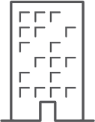
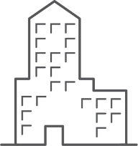
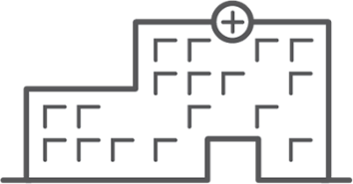
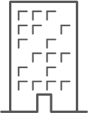
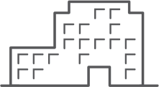
Extending Wi-Fi 6 to New Verticals and Use Cases
RETAIL, LOGISTICS
EDUCATION
High performance AI-powered Wi-Fi with cloud services
Turn by turn location services with 1-3 meter accuracy
Mobile ad/offer notification to boost store revenues
Outdoor Wi-Fi for order prep time and curbside pick up
Detailed analytics and automated store IT operation
High performance AI-powered Wi-Fi for high density learning
Best-in-class user experience with easy guess access, detailed network/device insights, and automated operation
Optimized resources across campus with Mist cloud services
Location services with event/sport ads, campus tour…etc.
PUBLIC SECTOR
CORPORATE OFFICE
HEALTHCARE
Reliable high-performance outdoor Wi-Fi with AI
Client level visibility and automated troubleshooting for unprecedented user experience
100% API – based programmability and ZTP for scale and easy deployment
Location services for direction and push notification
High performance AI-powered Wi-Fi with cloud services
Automated operation and insights for soaring IT/IoT devices in high density office environments
Easy guess access, fast roaming and the best SLE across all devices and applications
Location services with turn by turn direction, meeting room booking, and company notification push
High performance AI-powered Wi-Fi for better connected health with soaring IoT/IoMT/IT devices
Location services with mobile check-in, direction, messages/alert notification, assistant finding, and door lock
Network and device insights for simplified troubleshooting and automated operation
The best SLE across the entire health org with IT/IoT/IoMT devices

Slide 11
How To Position the AP’s When Selling
 | AP43 | AP33 | AP32 | AP12 | AP63
Primary Environment | Office, Retail, University, Hospital | Retail, Primary Education | Branch Office, Clinics, Professional Services | Dorms, Home, Hotel (wall) | Outdoor, Warehouse, Factory
Density Need | Highest Density | High Density | High Density | Low Density | Highest Density
Performance Needs | Highest Performance | High Performance | High Performance | Moderate Performance | Highest Performance
Need for Location | High Accuracy Engagement, Assets, Proximity | High Accuracy Engagement, Assets, Proximity | Low Accuracy | Low Accuracy | High Accuracy Engagement, Assets, Proximity
Need for IoT Integration or Sensors | Yes | - | - | - | -
Relative Cost | **** | *** | ** | * | *****

Slide 12
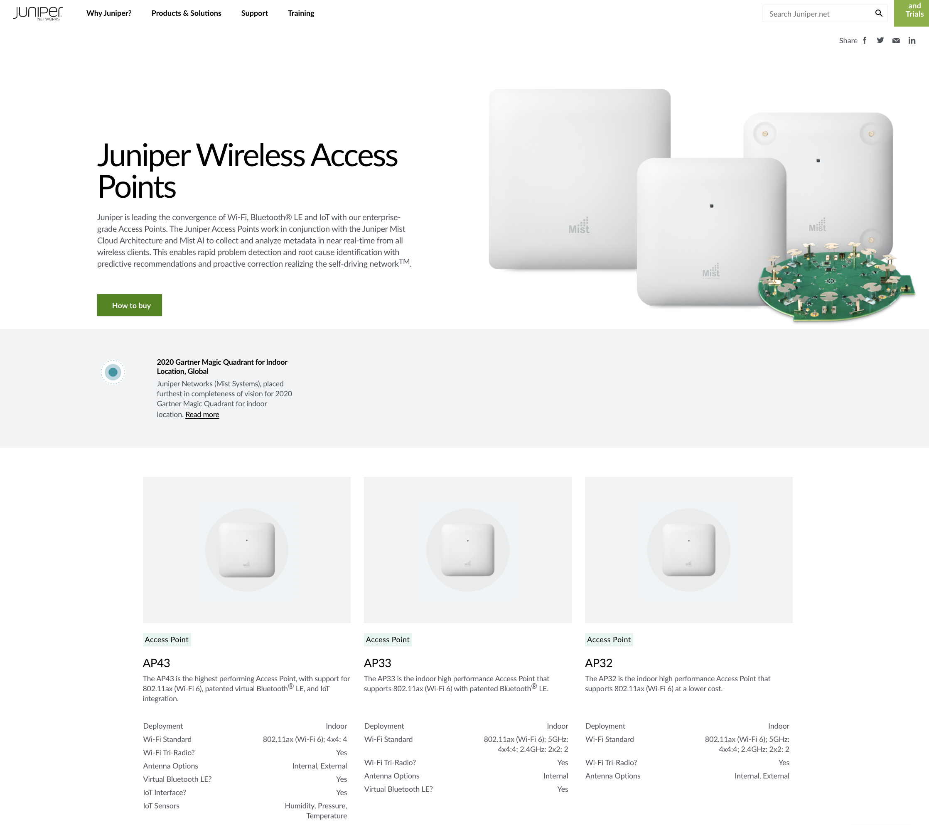
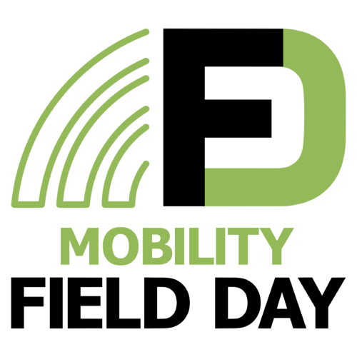
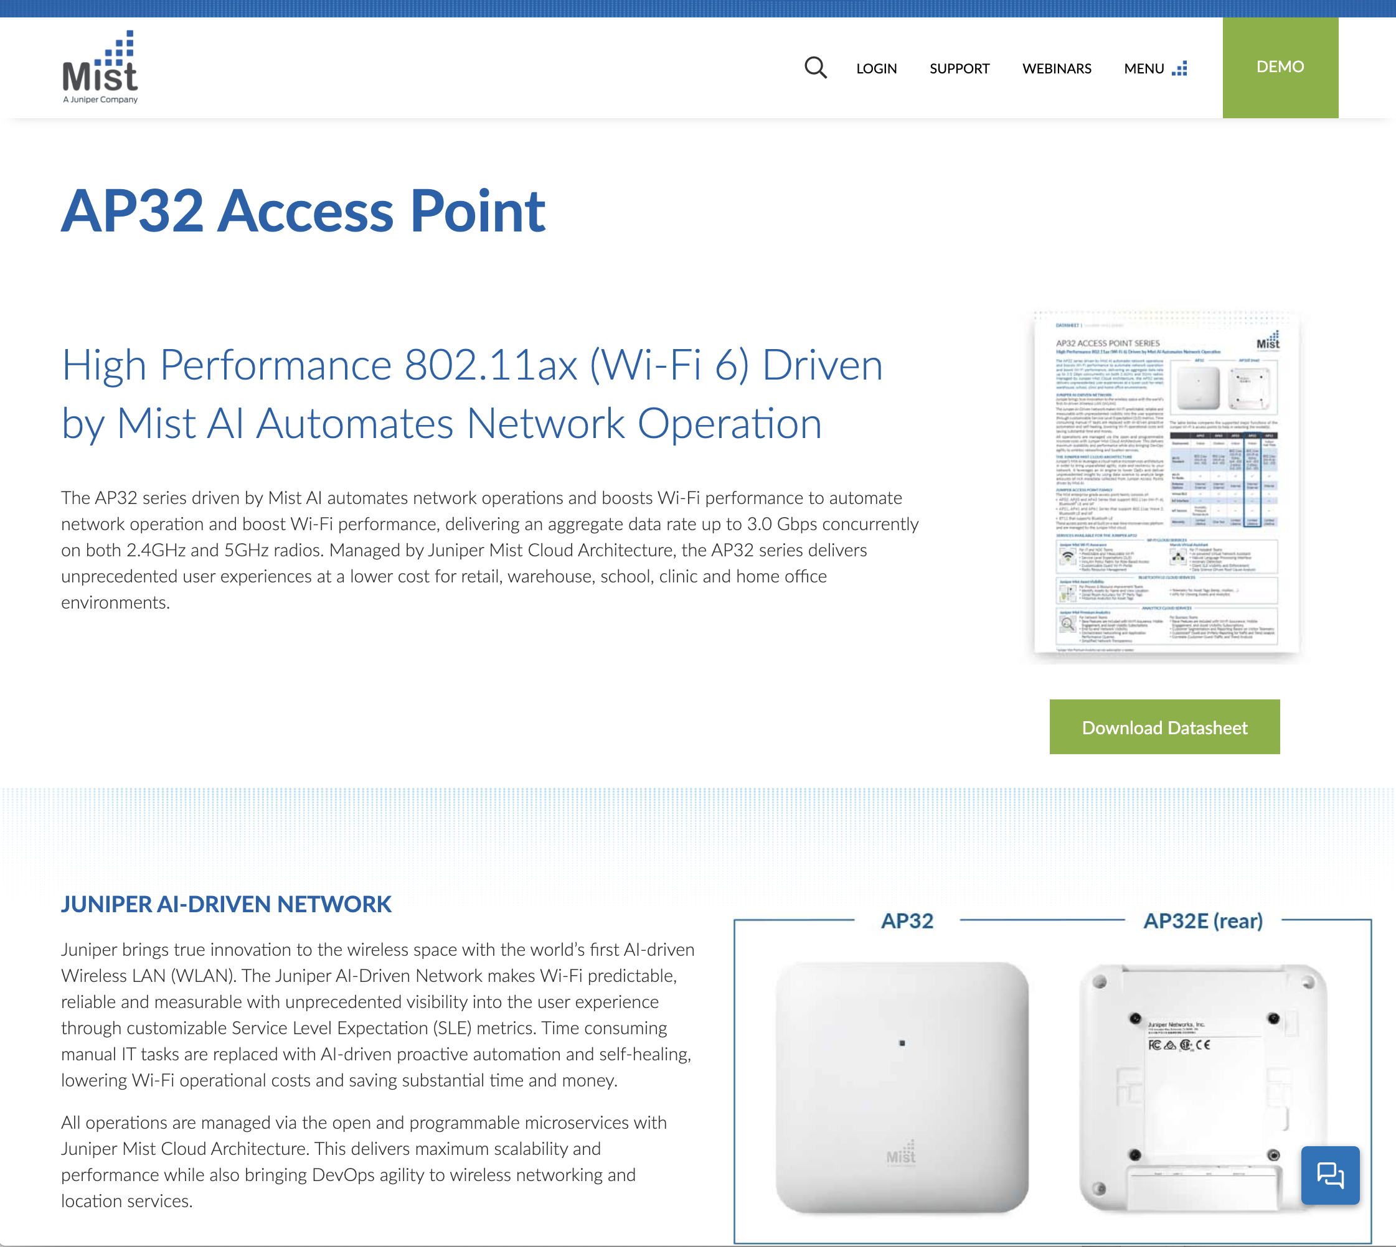
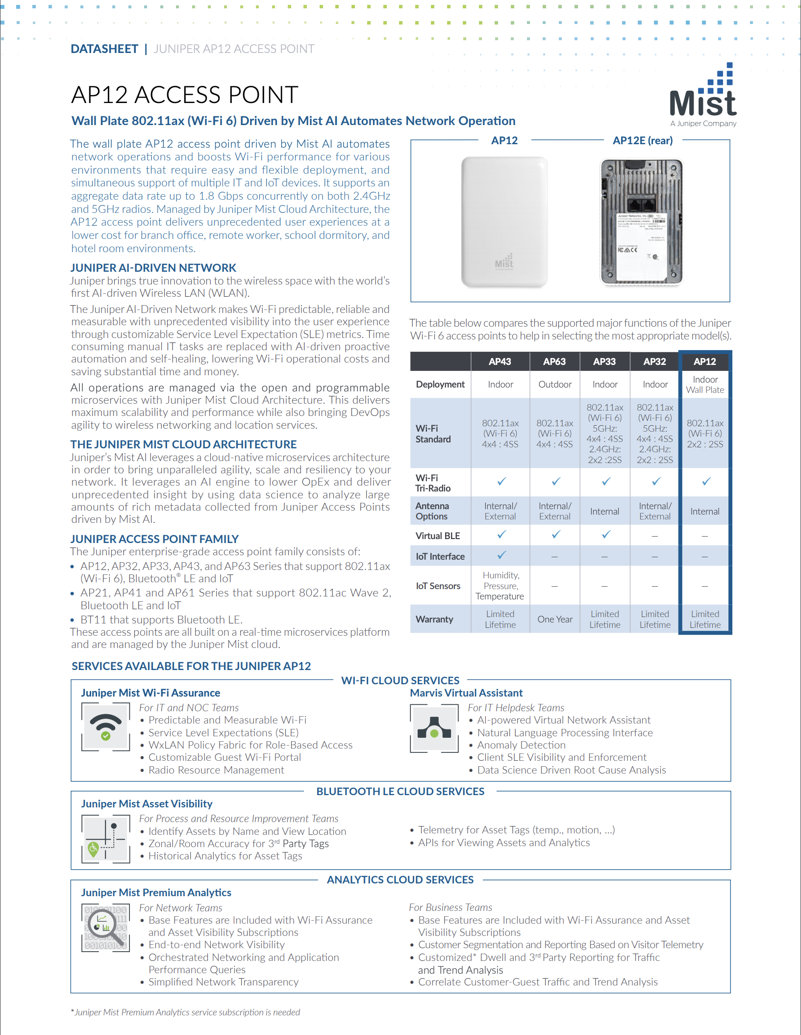
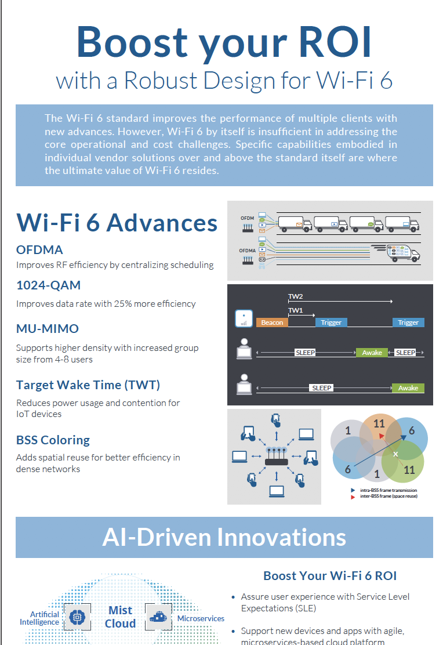
Resources
New and Updated Content on juniper.net and mist.com
July 29th @ 8am PDT
Watch Live/Replay:
https://bit.ly/mfd-mist
Datasheets for the new Access Points
Wi-Fi 6 Infographic

