Slide 1

Riverbed® SteelHead
What’s New
SteelHead 9.1
SteelHead 9.2 New Feature & Updates
Presenter Name
Title here, Company

Slide 2
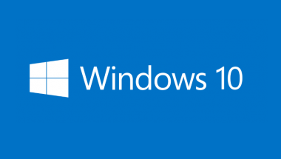
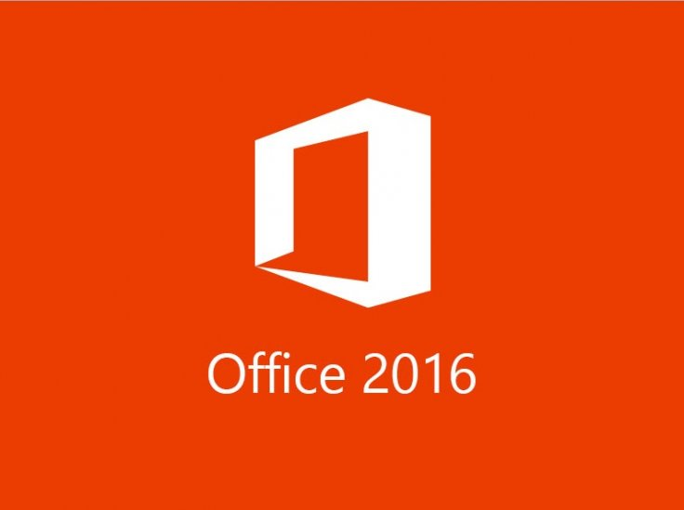
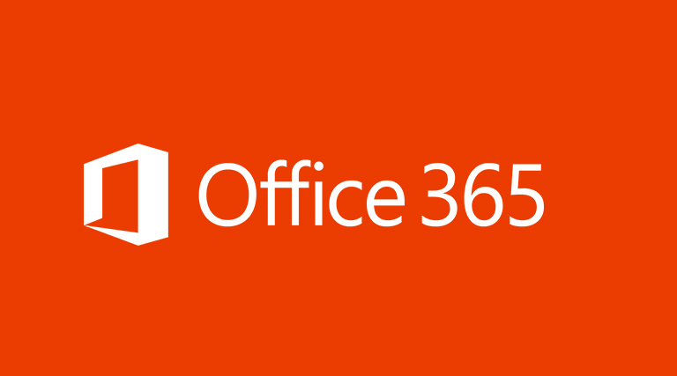
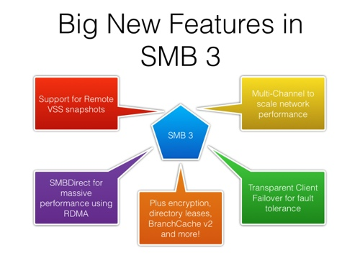

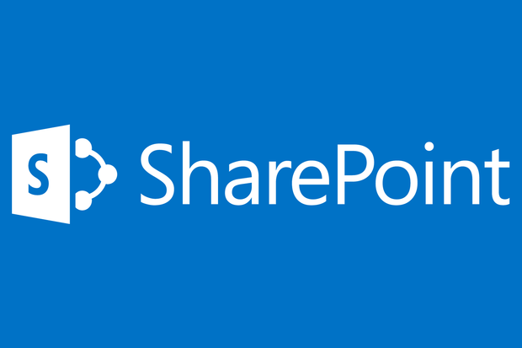
Windows 10 / Office 365 / Office 2016
SteelHead 9.2
SMB 3.1.1
MAPI over HTTP
Notes:
Microsoft’s Windows Operating System continues to be the market leader, and Windows 10, released in Summer of 2015 is already used by over 270 million users.*
SMB 3.1.1 - Accelerate file sharing among Windows 10 and Windows Server 2016 systems
SMB generates a large amount of traffic in customer networks. SMB 3.1.1 arrives with Windows 10 and Win Server 2016. This blade provides both data reduction and app acceleration.
MAPI over HTTP - Accelerate and reduce data consumption across the most popular email system and its newest protocol variant
MAPI generates a large amount of traffic in customer networks. MAPI over HTTP is the newest protocol variant that arrives with both Office 365 and Exchange 2016. Devon includes MAPI over HTTP acceleration and data reduction.
HNBI for O365 Dedicated
These are enhancements to existing optimization features. HNBI provides wildcard domain definition in in-path rules. IP address based interception rules can be cumbersome to manage, so we’ve made it easier to manage and maintain in-path rules.
*http://www.winbeta.org/news/windows-10-continues-climb-market-share

Slide 3





















Hybrid Networking Improvements
SteelHead 9.2
Config Push Support
PSIC Auto Channel Config
PSIC Throughput Improvements
User-Definable Probe Addresses
PS Transit Site Support
Scale to 500
Hybrid Applications
SaaS
Hybrid WAN
Internet
Branch
MPLS-A
MPLS-B or
Internet
Data Center
General notes about Platform slides:
Title is taking focus – platform should be the focus; make it larger, it should take up about a quarter of the slide. It also looks more transparent now. If you need, you can put a white box behind it.
For text in bottom table – vertically align text so that it is centered between lines. Make “TM” smaller after each word.
Notes:
A recent study from IDC shared that on average, companies are operating 55 remote IT locations for every ONE data center. That’s a lot of THINGS to manage for IT.
SteelHead continues to simplify managing performance across the hybrid enterprise with the following enhancements.
Config Push Support - Faster configuration deployment from SCC
PSIC Auto Channel Config - Automatically support Interceptor cluster setup for cluster channels for path selection
PSIC Throughput Improvements - Path Selection on Interceptor bandwidth approaching 3 to 4Gbps
Probe Improvements –
QoS on Path Selection Probing
IP Address per site is user-selectable
Probing frequency reduced on unused paths
PS Transit Site Support - Automatically support hub sites
Scale to 500 Increase from 200 sites in 9.0/9.1

Slide 4

SSL Acceleration Improvements
SteelHead 9.2
SSL Proxy Cert Enhancements
SSL Passthrough Expired Proxy Cert
Gemalto HSM
TLS 1.2 Hardening
Notes:
Since compromise is not an option when it comes to security, SSL-based securitization of applications is no longer optional. SSL is the new TCP. Modern applications are encrypted, making it difficult to identify, classify, and appropriately prioritize. SteelHead solutions can seamlessly intercept and optimize this SSL data as if it were any other traffic. We’ve added some new enhancements to make it even easier to manage optimization of SSL traffic.
SSL Proxy Cert Enhancements supports Subject Alternate Name (SAN) field in certificates to reduce SteelHead administrative burden in environments with multiple security domains. Proxy selection based on wildcard SAN matching further helps in environments where SteelHead operators have no direct access to security certs.
SSL Passthrough Changes behavior of SteelHead to pass through traffic when proxy cert expires (previously blocked traffic).
Gemalto HSM allows certs to be stored in an approved third party hardware device (this integration is for Gemalto), rather than the SteelHead SecureVault. This provides vetted integration with the HSM provider, Gemalto.
TLS Support latest TLS version in release

Slide 5

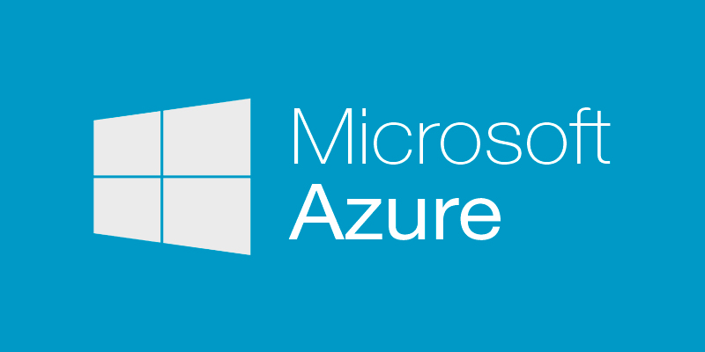
Virtual and Cloud Improvements
SteelHead 9.2
NEW! KVM-based SteelHead Virtual Edition
Upgraded Cloud SteelHead in Microsoft Azure
  CX-5070c
Notes:
SteelHead virtual products have been offered for VMware vSphere and Microsoft Hyper-V hypervisors. With SteelHead 9.2 we will now also offer the ability to run a virtual SteelHead on a KVM (Kernel-based Virtual Machine) hypervisor as well.
KVM is included in the standard Linux distributions. KVM is open source software.

Slide 6
RiOS 9.2.0 Release Products
SteelHead “Devon” (xx55, xx70)
SteelCentral Controller for SteelHead (CMC 8150, SCC 1000)
Interceptor (9350, 9600)

Slide 7
Thank You

