Slide 1
SteelHead Mobile Solutions
Notes:
Image Credit – Shutterstock

Slide 2
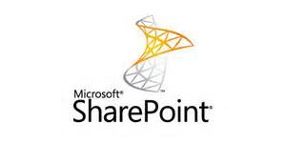
A Day in the Life of Tom, a Mobile Worker…
Tom uses SharePoint to collaborate and share documents securely with his team back at the office
+
+
From Starbucks or home or from a client site
FRUSTRATION (even embarrassment) from SLOW Internet!
Notes:
So lets start with a quick day in the life of a typical mobile worker – I’m sure most of you can empathize…
Tom is trying to use Sharepoint to collaborate and share documents with his team back at the office.
Wherever he connects, he needs to be sure his information is secure – even at Starbucks. He becomes beyond frustrated by the painfully slow Internet connection and time wasted uploading documents to Sharepoint.
Later when he’s working at home – of course his kids are watching NetFlix, Tom can’t work because of the slow connection to Sharepoint from his home network…
Tom REALLY needs SteelHead Mobile - now more than ever!

Slide 3
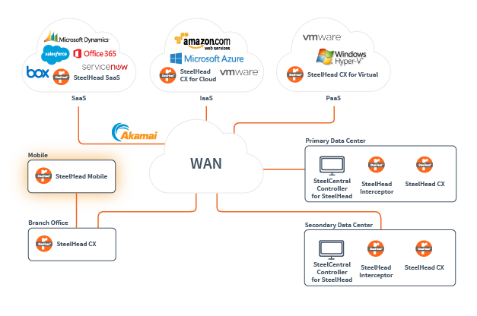
SteelHead Mobile
Enabling Distributed Workforces in the Hybrid Enterprise with Application Performance Anywhere
More than 50% of McKinsey’s workforce almost exclusively works out of their branch from remote sites, customer sites or home...
~McKinsey
46% 2016
63% by 2020
~Gartner on Enterprises Using ONLY Laptops and Mobile devices, May ‘14
Notes:
Workforces are becoming more and more mobile everyday – and just like YOU need to stay productive – so do your customer’s workforces.
More than half of McKinsey’s workforce almost exclusively works remotely or from home offices.
According to Gartner, by next year 46% of enterprises will be using mobile devices for getting their work done, and in just 5 years, that will be up to 63%.
Think about it. Think about your pool of customers and prospects, and how employees work remotely or out in the field….
So, how can you improve productivity for remote workers while enhancing IT control and visibility?

Slide 4
The SteelHead for Mobile Enterprise
Collaboration
Security
Scalability
SteelHead Mobile 4.8 – Now on Windows 10
Notes:
Since 2002 Riverbed has helped enterprises optimize application performance for branch workers.
Our SteelHead Mobile solution brings SteelHead’s industry-leading benefits to your remote workers. Employees, for example, who work from home, an airport or the client’s site.
SteelHead Mobile implements the award-winning transport, protocol and application streamlining technology in a software-only form-factor that remote users can conveniently install on their laptops as software clients.
With SteelHead Mobile you can enjoy benefits of solid application acceleration for a wide variety of critical enterprise apps ranging from email, file sharing, collaborative applications, Intranet portals, Web apps, Line-of-business apps, as well as ERP, CRM and database software suites providing substantial bandwidth reduction and up to 100x improvement in latency.

Slide 5
SteelHead Mobile - Business Benefits
Improves Mobile Worker Productivity
Streamlines IT Management/Reduces Support Costs
Offers Visibility and Control – SteelCentral Controller
Accelerates business-critical applications up to 60x
Reduces bandwidth by up to 99%
Eliminates performance problems caused by bandwidth constraints, latency, and competition among applications
Provides an integrated mobile worker, branch office, and data center solution
Transforms global enterprise data centers to support large-scale mobile deployments
Scales to support up to 20,000 concurrent active mobile clients with SteelCentral Controller for SteelHead Mobile
Provides ease of provisioning and management with simplified policy configuration, interactive graphs, and reporting
Delivers improved “native” visibility. It does not integrate with SteelCentral NetProfiler, NetShark or App Response except on server side SteelHead
Notes:
With SteelHead Mobile, you can act as an “application traffic coordinator” for remote worker end points such as desktops, laptops and even the Windows Surface. You easily manage optimization and administer mobile clients centrally,keep on top of things with advanced reporting, and just like that, with SteelHead Mobile, your businss-criitcal aps are accelerated to remote workers anywhere!

Slide 6
Collaboration – SteelHead Mobile
MS SharePoint
Top 3 workloads optimized by SteelHead
Windows Protocols
Including SMBv2/3, Outlook Anywhere, Kerberos
Business Productivity Apps
Including SAP NetWeaver, JD Edwards, Siebel
Accelerates business-critical applications up to 100X
Reduces bandwidth by up to 99%
Provides an integrated mobile worker, branch office, and data center solution
Notes:
SteelHead Mobile improves mobile employee productivity.
Workers can access files more quickly, sharing and enabling better collaboration regardless of employee or data location. With applications accelerated by up to 100X and bandwidth requirements reduced by up to 99%, workers at remote locations with costly or restricted bandwidth and workers on the go, working from home, various branches or even the airport can access the data they need, share with other employees, partners or customers. Data stays current, secure and moves with your business.

Slide 7
Security - SteelHead Mobile
Encrypted Protocol Support
Secure negotiation and encryption
Support for all latest ciphers – SSL/TLS
Provides Client Access Control Support
VPN Support
Support for Palo Alto Global Protect, Cisco, SonicWALL and NetMotion
Visibility
Aggregated or individual statistics on throughput improvements and bandwidth optimization
Helps avoid man-in-the-middle attacks with secure negotiation
Extends security standards compliance to remote workers
Provides RADIUS/TACACS Authentication
Offers Role-based Management
Supports end-to-end network monitoring and reporting through seamless integration with SteelCentral NetProfiler
Notes:
In today’s dynamic application and networking landscape, security is not just a buzzword and is actually the most critical consideration for any remote access solution.
SSL based securitization of applications is no longer optional and SSL support turns out to be a fundamental building block for most new-age applications.
SteelHead Mobile is uniquely capable of providing the same acceleration benefits for any SSL or https based application without compromise to any of your security policies.
Additional security features include RADIUS/TACACS authentication, secure role-based management and support for CAC (Common Access Card) as well as FIPS compliance which can be critical in Federal markets.

Slide 8
Scalability – Built for the Hybrid Enterprise
SteelCentral Controller for SteelHead Mobile
Clusters of up to 80,000 users with auto licensing
Concurrent licensing model (licenses pool)
Compatibility for high-availability configurations
Consistent HW architecture with SteelHead CX 70 Series - purpose built for the hybrid enterprise to carry a higher load
Notes:
When there are a large number of remote users that need to be supported - scale becomes a critical factor for implementing any solution. The SteelHead mobile solution is based on a centralized controller based architecture where a single controller can support up to 20K users, and if deployed as a high-availability cluster can support up to 80K users. The controller facilitates support of large scale client deployments with convenient easy-to-deploy MSI packages thus relieving a huge burden on the IT folks in terms of regular maintenance including policy and software updates.
The solution can scale to support up to 80,000 concurrent mobile clients and supports applications both on premises and in the cloud.

Slide 9
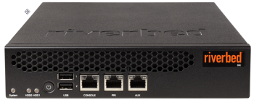
SteelHead Mobile - Powerful Features
Centralized Policy
Packages for Rapid Client Deployment
Optimization/End-point Policy Templates
License/SW-Upgrade Management
Advanced Reporting
Optimization and Application Performance
Client Health Report
Aggregate and Individual End-point Reports
Accelerate Business Critical Apps
ERP/CRM Apps
Microsoft SharePoint, and Windows Apps (e.g., SMBv2/3, Outlook anywhere, Kerberos)
Security
Accelerate SSL/HTTPS
RADIUS/TACACS Authentication
Role-based Management
CAC Support
Scale and HA
Supports up to 20K concurrent users
SteelCentral Controller for Steelhead Mobile Clustering
Large scale client deployment with MSI packages
Broad OS/VPN Compatibility
Windows 7/8/10, MAC OS X 10.9/10.10
Juniper, Cisco, Netmotion, Palo Alto VPN Clients
Notes:
SteelHead mobile
…make your life easy with centralized policy management.
…gives you a birds eye view with advanced reporting.
…gets your apps moving with support for the most business critical apps
…gives you peace of mind with native security
…lets you grow and keep moving with high availability, scale and broad compatibility

Slide 10
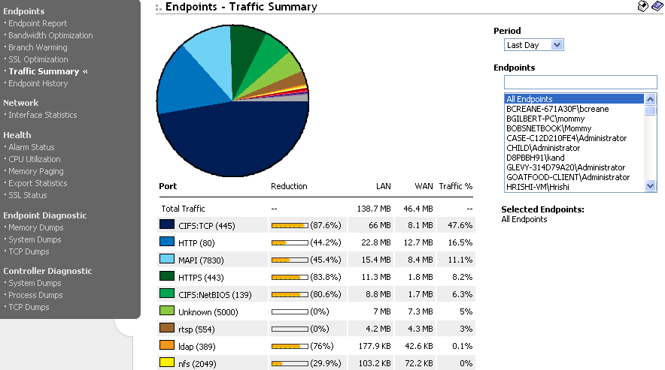
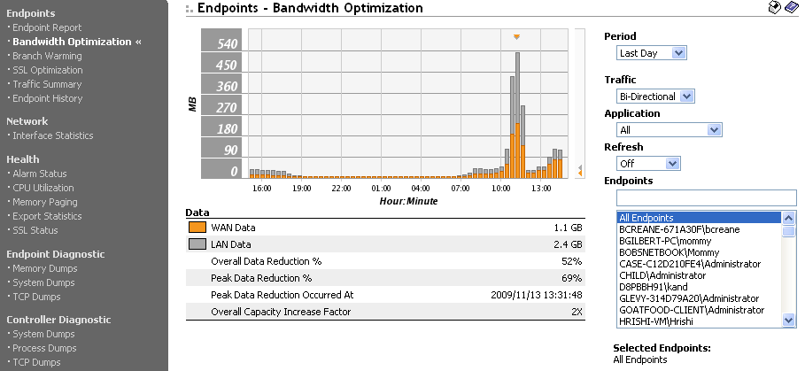
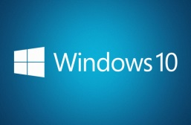
SteelHead Mobile – Native Visibility
Aggregated and End-point Performance Reports
Client Health Monitoring
Comprehensive Alarms Library
Event Notification Engine with SNMP, Syslog, Email
Job Scheduling / Software Upgrades
Notes:
Screenshots of aforementioned visibility – go through bullet points

Slide 11
SteelHead Mobile Solution Components
SHM Client Software
SteelHead Mobile Controller
Virtual SMC
Deployed on Windows and MAC Laptops as well as Surface Tablets
Zero touch Client Configuration
Non-intrusive invisible mode of operation
Provides ease of provisioning and license management
Advanced Visibility and Reporting
Supports up to 20K concurrent mobile users
Clustering for Scale and HA
Virtual package supported on ESX Hypervisor and Riverbed Services Platforms
Up to 4000 concurrent mobile users
Small Strategic Deployments

Slide 12
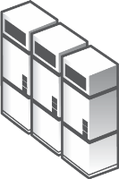
SteelHead Mobile Sharepoint Optimization Use Case
Branch Office
Corporate Data Center
Steelhead CX
SteelHead CX
Exchange Email Servers
WAN
SharePoint
Server Farm
Internet
Home Office
SteelHead Mobile
Multi-fold boost in remote worker productivity
Accelerated access to Sharepoint Servers in DC
Speedy Upload/Download/Updates for huge PowerPoint, Word and Excel Docs in Sharepoint
Immediate access to big Email Attachments
Enable Efficient and Fast Collaboration for remote worker as if they are sitting right there in the branch office
Notes:
SteelHead mobile enables optimization for applications that reside either in a branch, data center or hosted in the private and public clouds such as Azure and AWS effectively ensuring location-independence for both the applications and the end users that are accessing those applications.

Slide 13
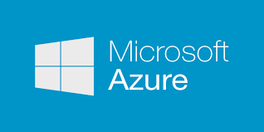
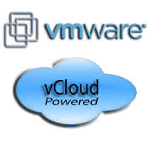
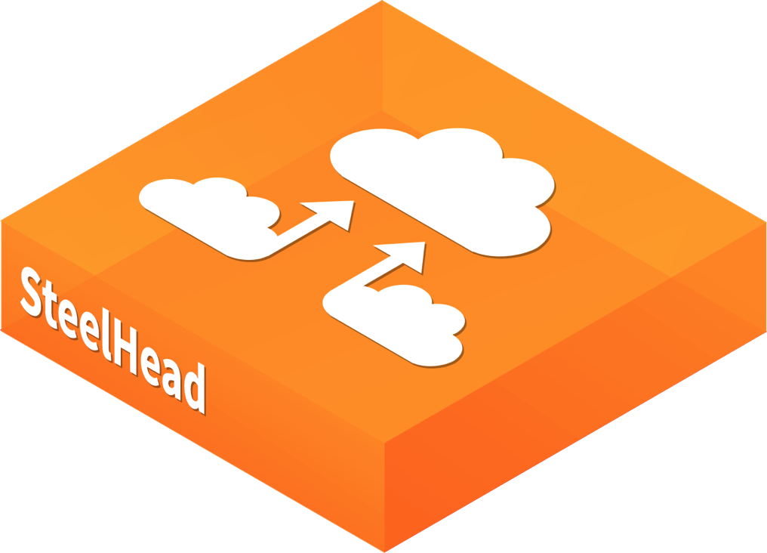
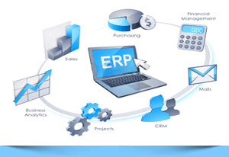
SteelHead Mobile for IaaS Optimizing Public Cloud Use Case
Airport/Hotel
SteelHead CX for Cloud
Internet/VPN
SteelHead Mobile
Direct Optimized Access to Cloud Apps
On-the-go Acceleration for CRM/ERP and Enterprise Web-Apps
Accelerated Access to File Servers in Cloud (Azure File Services)
Fast Access to Storage, Back-up and DR in cloud
Notes:
SteelHead mobile enables optimization for applications that reside either in a branch, data center or hosted in the private and public clouds such as Azure and AWS effectively ensuring location-independence for both the applications and the end users that are accessing those applications.

Slide 14
SteelHead Mobile – Microsoft Environments
Aura Light International
IAT Group
DC Leisure
“…the reason we felt comfortable going with Riverbed was the availability of SteelHead Mobile, which extended the benefits of WAN Optimization to (our) salesforce who use laptops exclusively”
http://www.riverbed.com/customer-stories/Aura-Light.html
“With SteelHead Mobile, field agents uploading and copying files to headquarters, take a fraction of the time it did previously.”
“Deploying Riverbed has saved DCL hundreds of thousands in leased line costs… and for our remote sites we now use Steelhead Mobile.”
www.riverbed.com/customer-stories/IATGroup.html
http://www.riverbed.com/customer-stories/dc-leisure.html
Notes:
DC Leisure is a leisure management company managing over 85 sites around the UK, and with 6500 employees, many of whom work remote.

Slide 15
SteelHead Mobile Enables Business Growth
Challenge
Benefit
Poor App Performance
Bandwidth Limitations at Remote Sites
Collaboration Difficult
Scale Better to Support Growth
Increased Employee Productivity
60-80% Less Traffic Across WAN
2 year ROI
The efficiencies and flexibility our employees have gained from this
technology translate to real dollars…The use of Riverbed technologies has helped us tap into new markets and new geographic areas.
“
”
Abe Esguerra
IT Director
Notes:
http://media-cms.riverbed.com/documents/0111_Dudek_Associates_032515AS-3.pdf
http://www.riverbed.com/customer-stories/Dudek--Associates.html
Dudek is a California-focused environmental firm with headquarters in Encinitas and 12 sites located around the state of California. Employs more than 300 planners, scientists, civil engineers, contractors, and support staff. Since 1980, the firm has provided its clients with environmental, permitting, planning, engineering, construction, and operational services.
Challenges:
Create an IT environment that enables interoffice collaboration and easily scales with the firm’s growth
Provide fast access to data and applications regardless of employee locations
Meet the terms of an acquisition regarding availability of centralized data storage
Solution: Riverbed Application Platform™ for optimization, visibility, and control across the hybrid enterprise
• 15 SteelHead™ virtual and physical appliances
• 50 SteelHead Mobile licenses
• 1 SteelFusion™ solution
Result:
Fast access to applications and large data files support collaboration and increases employee productivity
Great application performance despite employee location or distance from data center
60-80% reductino in WAN traffic
ROI – Original SteelHead deployment paid for itself two-fold in less than a year.

Slide 16
SteelHead Mobile Enables Business Growth
Challenge
Very mobile workforce
Multiple small offices with few workers
Project files slow to download and share
Benefit
Increased productivity
LAN-like access to files and data from any location
Small office bandwidth requirements supported affordably
For us, the solution for the mobile worker started as a ‘nice-to-have.’ Shortly thereafter we realized it was a ‘must-have’ to enable our employees to work from everywhere.
“
Patrick Dix,
IT manager
”
Notes:
Source http://media-cms.riverbed.com/documents/Riverbed+Case+Study+JEO+Consulting.pdf
JEO has provided clients with engineering consulting services that enhance the quality of life for communities and individuals alike. The 120 employees provide services to clients throughout the Midwest. JEO’s engineers, architects, surveyors, and planners work in concert with skilled technicians and support personnel to deliver creative and cost-effective solutions.
The challenges for JEO included:
The firm’s workforce is quite mobile
Trying to remotely download a set of project files and CAD drawings could take 60 minutes or more
Need to accelerate access to large design files and project documents
Provide LAN-like access to data and applications to employees working in small towns, at home, and on the road
The solution for them was:
SteelHead appliances in data center and 10 offices
SteelHead Mobile deployed on approximately 60 users’ laptops
“Awesome” Riverbed technical support
And the results:
Offices can be affordably located in small towns with limited bandwidth
End users have LAN-like access to files and data from any location
WAN optimization solution is easy for IT to manage

