Slide 1
SteelCentral Что Нового
Апрель 2017
Темы семинара:
Brexit Happened - что дальше?
2) Future of Gibraltar at stake in Brexit negotiations
3) Англия сегодня
Notes:
Welcome. My name is <presenter> and I’m about to share Riverbed’s vision of the evolving IT trends that we are seeing within our customer base. We’ll discuss the various degree of transformations within the IT architecture. We’ll discuss the evolving challenges IT executives have to face, and we’ll discuss how Riverbed is addressing those challenges today. Finally we’ll share with you our technology plans to increase the value we are providing to you and your organization.

Slide 2
Концепция мониторинга Riverbed
Portal
оценка с точки зрения пользователя
производительность сети
производительность приложений
Notes:
Перерисовать/ дополнить
Итак что мы проповедуем?
в отличие от многих конкурентных решений, Riverbed Performance Management единственный производитель предоставляющий возможность мониторить и связать воедино три важнейшие составляющие современной инфраструктуры доставки приложений.
Более того – наши решения по оптимизации трафика проектируются с учётом необходимости отслеживать пользовательский опыт, состояние инфраструктуры и производительность приложений.
Таким образом мы можем предоставить наиболее полное и изящное решение мониторинга производительности критически важных приложений в не зависимости от их сложности .

Slide 3
Теперь вместе с EUEM Полная, Интегрируемая и Модульная Платформа
CMO/CEO
CIO
LOB
DevOps
AppOps
NetOps
ITOps
Полнота
Интегрированный Мониторинг
полнота
Пользователи и Приложения
Сети и Инфраструктура
Глубина анализа
Portal
Охват данными
1
Aternity
3
NetProfiler, UCExpert
2
глубина
AppInternals
AppResponse
NetIM
Детали-зация
SteelCentral является наиболее законченным, модульным и интегрированным решением мониторинга производительности в индустрии:
Мониторинг конечных устройств, приложений, сетей, инфраструктуры, в любой точке при любой компоновке
Признанный лидер в двух категориях: (i) App and EUE monitoring & troubleshooting, (ii) Network and infrastructure monitoring & troubleshooting
Notes:
Aternity has helped enterprise customers around the world address four major technology transformation trends, and I’ll show you a short demo tailored to the challenge that is upper-most on your agenda. Which of these areas is keeping you up at night?
<sales, if you run this deck in slide show mode, you’ll get a hyperlink by hovering over the top black section of each of the 4 columns. If you click on the hyperlink, you’ll be brought to the section in the back part of the deck that provides a list of the top business and technical challenges addressed by other customers for each of the 4 areas. Your goal for this slide is to have a discussion w/customer to extract their top challenges in whatever initiative is of highest concern. If you can do this without going to the back of the deck that’s OK, so long as you generate discussion.>
<sales, if you want to cite some examples of successes we’ve had in these area, or if you get asked, here’s a summary>
CHANGE MANAGEMENT: MULTI-NATIONAL TECH & CONSULTING COMPANY: Eliminated 98% of manual stop watch testing for 7,500 end users after successfully migrating Siebel from Tokyo to a new Sydney data center
VIRTUALIZATION: LARGE CHEMICAL PROVIDER: validated no degradation in compliance with SLA thresholds after migrating LotusNotes and SAP apps to VDI infrastructure, which is hosted by Dell
CLOUD : LARGE HEALTHCARE PROVIDER: Reduced time to do patient care business activities on its cloud hosted EHR app from approx 5 sec to approx 1 sec by identifying a problem in the app.
MOBILITY: GLOBAL COMMUNICATION SERVICE PROVIDER: transitioning from traditional check-in lines to iPads in stores. Aternity for Mobile is used to monitor the new app and to provide analytics around the impact of Wi-Fi, mobile, signal strength, retail store and model on the user experience and behavior. COMPANY is transitioning from laptops to “tech-on-premise” to iPads, due to the nature of their technicians being mobile – analytics of performance and usage by location and signal strength is critical.

Slide 4
Aternity биг бразер вотч ю

Slide 5
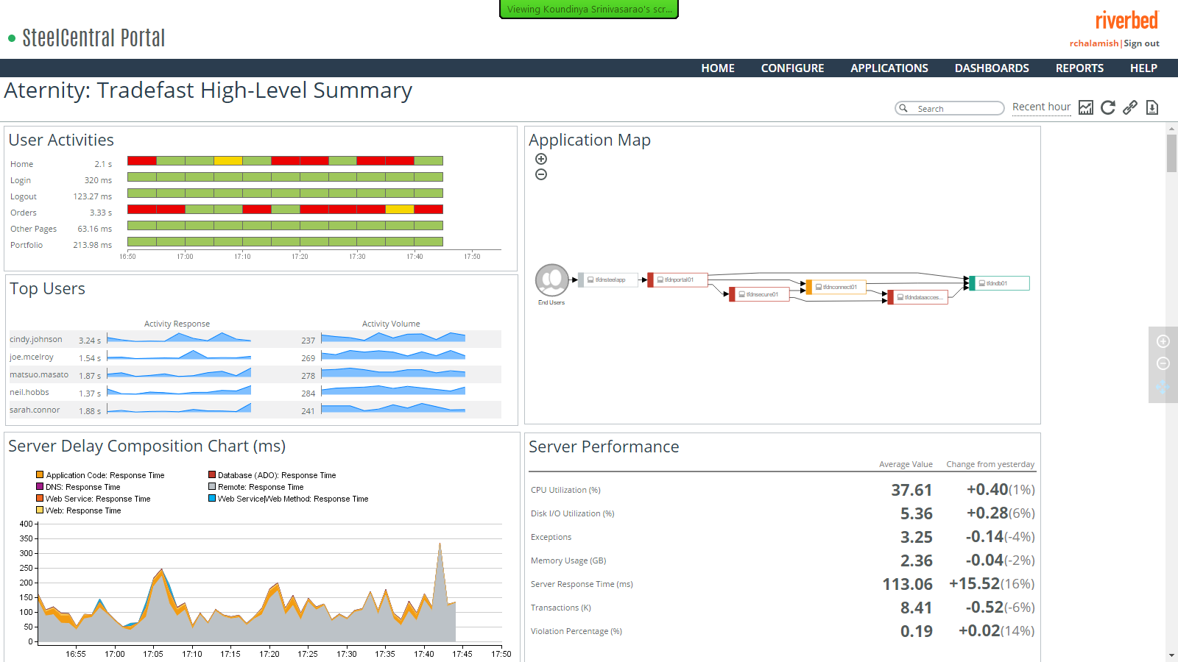

Slide 6
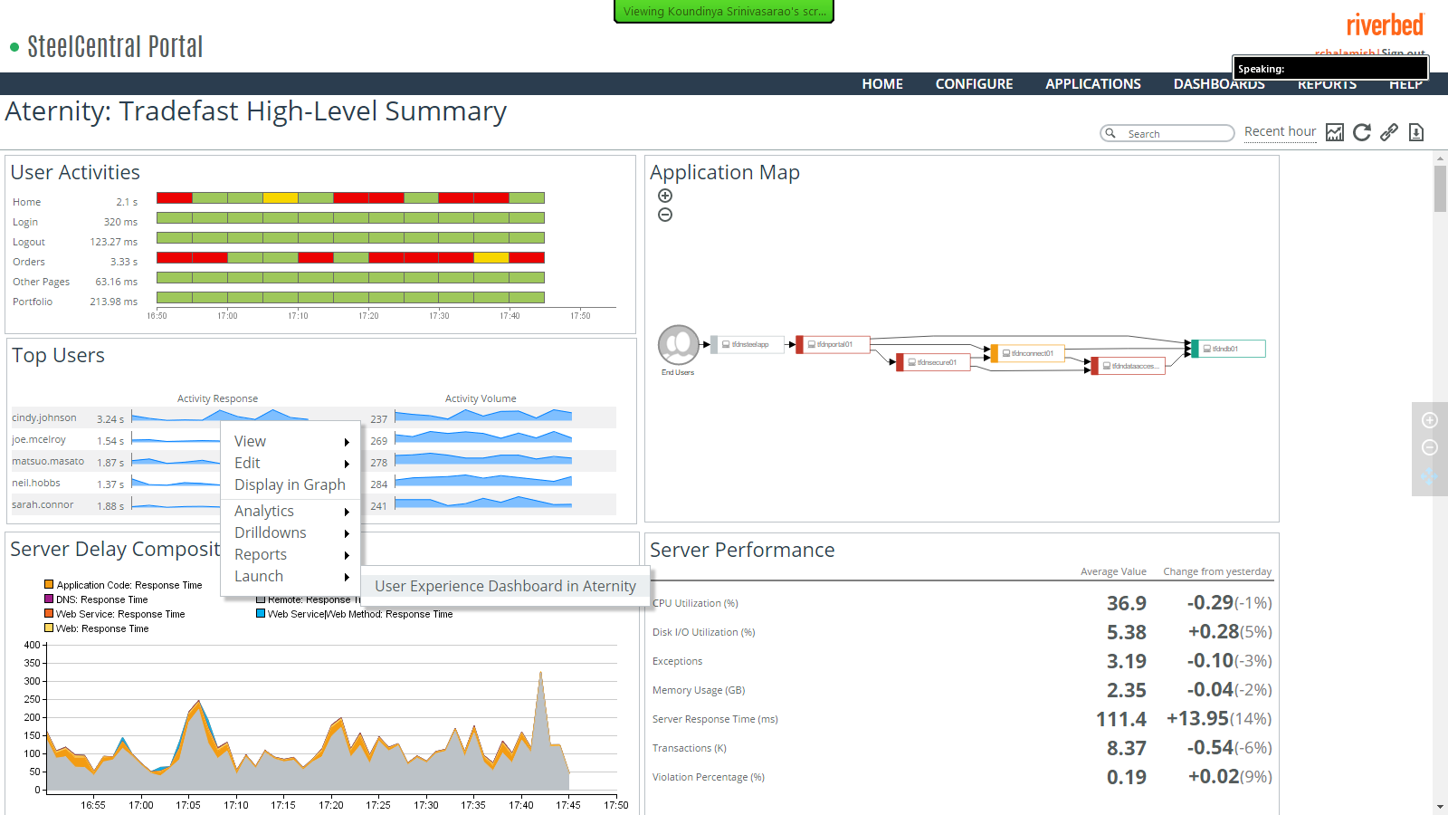

Slide 7
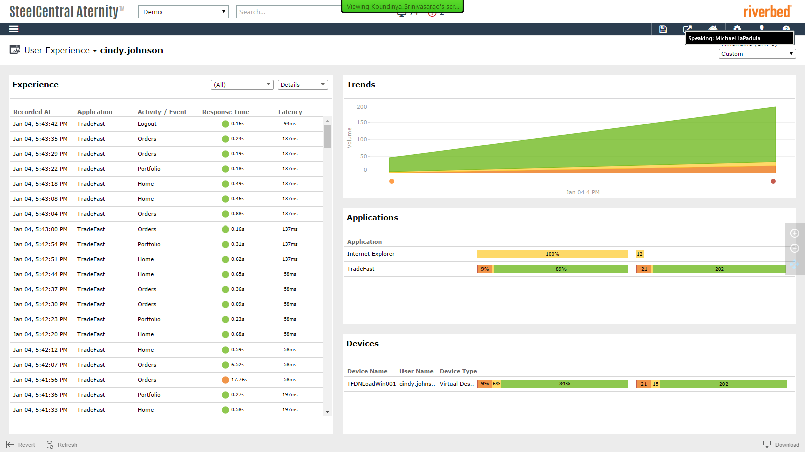

Slide 8
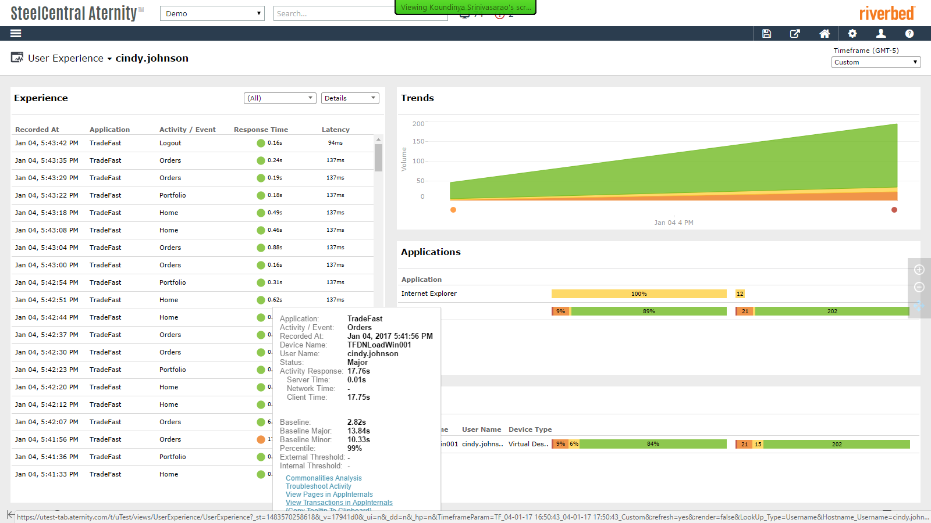

Slide 9
AppResponse 11 а где же Shark?

Slide 10
Capability By Release
Where we are and where we are going
SPA, ASA, WTA NetProfiler integration Flow export IPv6 support Full Virtual edition | Enhanced DB Module Small Hawk Appliance (2200, 3300, 3800) hardware support RADIUS/TACACS+ Portal Integration | Hawk Appliance (4300, 5100, 6000) Support 8170 40Gb NIC Storage State/Monitoring (incl. system alerts) AR9 Alert/Policy import Transaction Analyzer integration Enhanced UC Module Support FIPS Certification | Enhanced CX Module AD Support Portal Central Manager
Eagle+
Falcon
Gripen
Harrier

Slide 11
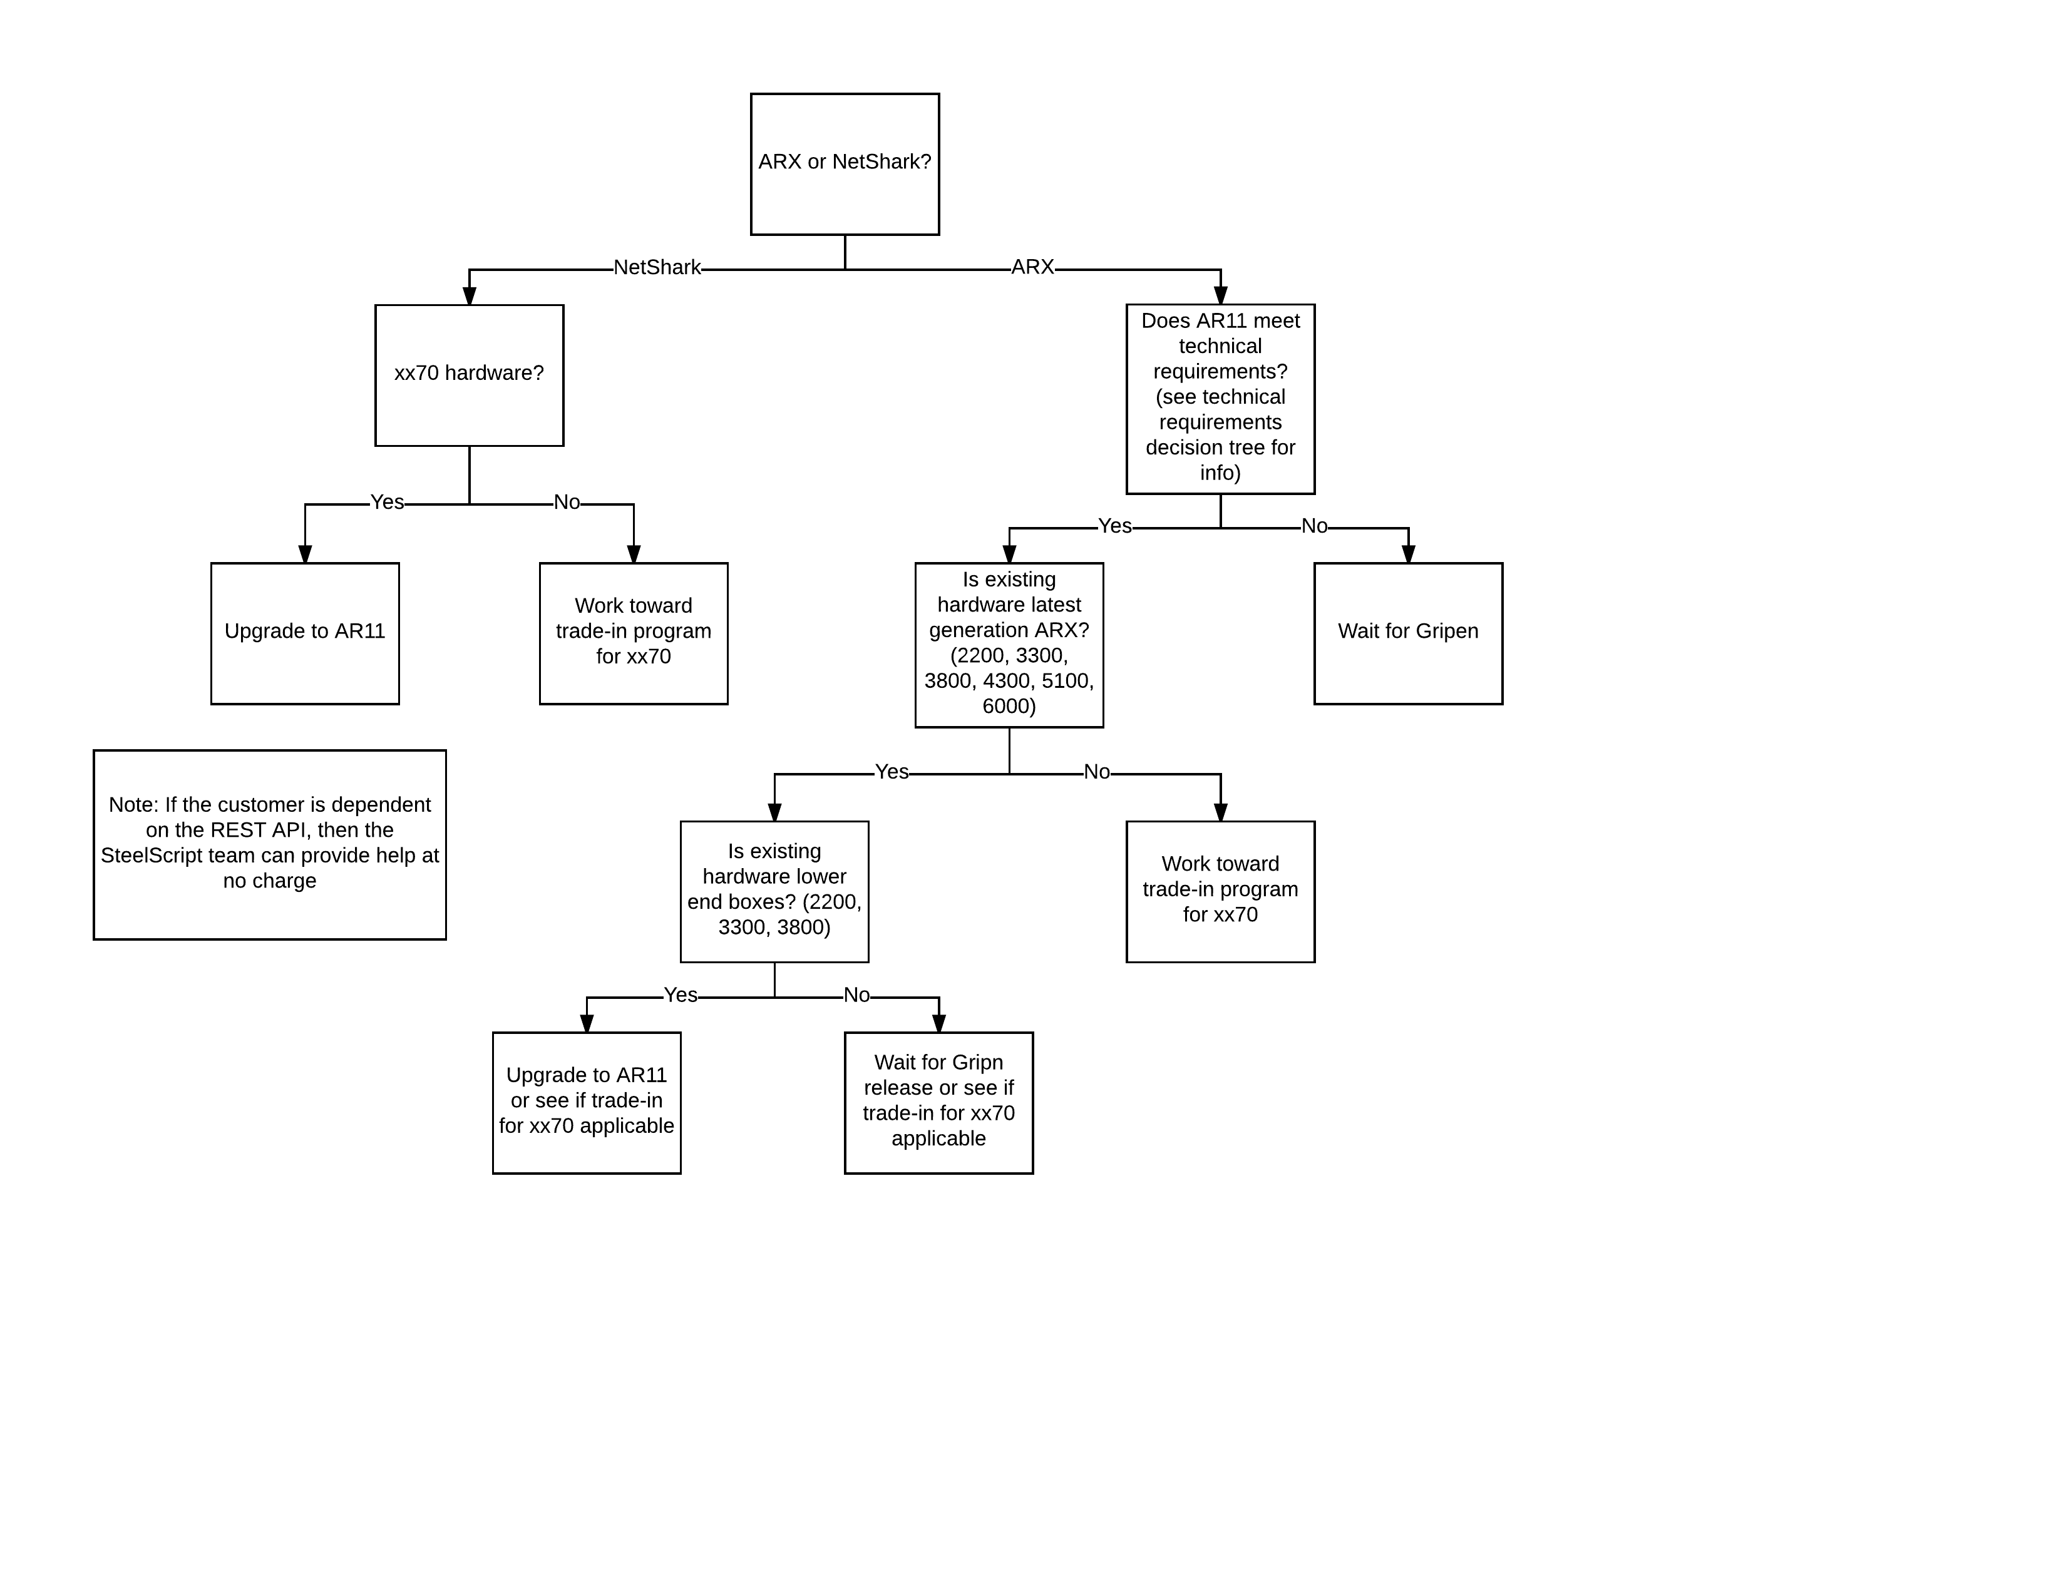
Existing Customer Decision Tree for AR11 Falcon

Slide 12
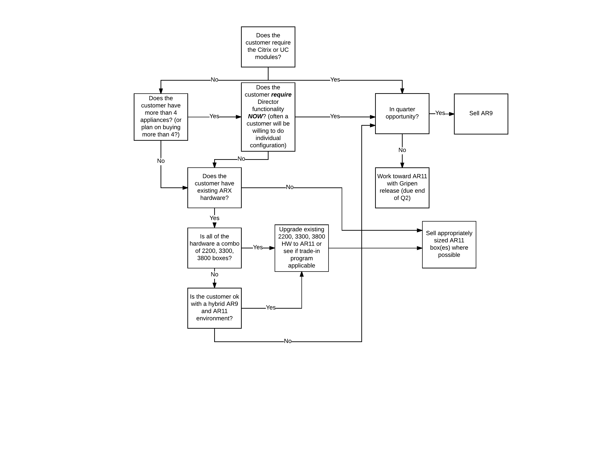
Technical Decision Tree for AR11 Falcon

Slide 13
AppResponse 11 или куда делся Alloy

Slide 14
AppResponse 11 Network-based Application Performance Management
HTLM5
Web UI with
pre-defined
Insights
HTTP/HTTPS application analysis
Network intelligence: 60+ TCP metrics
1300+ DPI engine
AppResponse 11
NETWORK FORENSIC
NETWORK ANALYSIS
APPLICATION
ANALYTICS
END-USER
EXPERIENCE
Easy collaboration across IT teams
Usable by novice and experts
Fast time to relevant answers
Notes:
Combines advanced application and transaction insight with deep network intelligence in a single appliance
Passive packet collection
Family of physical and virtual appliances
Real-time and forensic analysis
Captures all packets, all transactions, all users
Continuous end-user experience and response time monitoring
Response time, page load times
Seamless drill down into root cause
Transaction analytics
Real-time, historical, trending, alerting
Application insights
HTTP/HTTPS applications, SQL database, Citrix XenApp, VoIP and video
Quick drill down to individual users, transactions, applications, and flows
Network insights: TCP-based analysis with over 60 different metrics including end-user response time decomposition
Network delay, bandwidth consumption, packet loss, etc.

Slide 15
AppResponse 11 provides value across the enterprise
Network Operations
App Ops
App Owners
Web Team
Resolve Issues Quickly
Guarantee Service Delivery
Implement critical apps
Transform The Business
Proactively identify performance problems
Troubleshoot network issues
Prioritize problem resolution
Optimize app performance
Understand how network affects app performance
Understand app performance
Improver user experience
Diagnose user experience
Improve user productivity

Slide 16
AppResponse 11
Troubleshooting Monitoring
Flexible packet storage
Capture Jobs
Trace Clips
Watches
~1.3k auto-recognized apps
App-aware analysis
BGs, Apps, Alerts, Drilldowns
Web Transaction Analysis (WTA)
VoIP/Video
Database and Citrix
AppResponse 11 Software
2170
4170
6170
1200
2200
3300
3800
8170
4300
5100
6000
100v
500v
2000v
*Will include transition plan for prev. gen boxes, e.g., ARX 5000 → 4170

Slide 17
SteelCentral AppResponse 11
Network Forensics / Application Analysis / End-User Experience
Web Transaction Analysis (WTA)
Specialized Web-App Analysis (HTTP/HTTPS)
Focus on End-User-Experience for web apps
Performance for individual and aggregate user transactions, browser types, etc. …
Web Transaction Analysis
(WTA)
Future Modules
Optional Modules
Application Stream Analysis
(ASA)
Application Stream Analysis (ASA)
Always-on network analytics with roll-up metrics
60+ TCP and UDP metrics calculated
Response Time metrics – ALL users, ALL applications, ALL the time
Triage application problems
SteelCentral
AppResponse 11
Shark Packet Analysis (SPA)
On-demand packet capture & storage
Network forensics
Granular resolution, on-demand analysis
DPI capabilities
Run simultaneous capture jobs
Base Module
Shark Packet Analysis
(SPA)
Notes:
SteelCentral AppResponse 11 is completely new software and migrating from AppResponse 9 to AppResponse 11 is simply a software upgrade. <CR> The framework is modular in design starting with Shark Packet Analysis, the base or foundational module. Shark Packet Analysis provides Advanced Packet Forensics via on-demand packet capture with DPI capabilities, the ability to run multiple capture jobs simultaneously along with storage for Forensic Analysis. Today, customers can also purchase two additional modules to enhance their visibility and troubleshooting: <CR>
The 1st optional module is Application Stream Analysis or ASA with a focus on Network-Based Analytics, it provides:
Continual Real-Time analysis of over 60 TCP and UDP metrics
Response-Time Analysis of ALL applications, ALL the time <CR>
The next module is Web Transaction Analysis or WTA which is highly specialized for monitoring Web Application Analytics, it provides:
Detailed Web Application-Specific Analysis
End User Experience Monitoring
Web Transaction Performance and
Geographic Heat Maps that identifies where issues reside <CR>
Future modules are in development so be on the lookout !
All this functionality is provided in either physical or virtual appliance and can be used by cross-functional teams via SteelCentral’s Portal

Slide 18
Feature Packaging
Application Stream Analysis
Web Transaction Analysis
Unified Communications Analysis
Citrix Analysis
Database Analysis
AppResponse11
Optional
ASA
WTA
UCA
CXA
DBA
SPA
Built-in
2170
4170
6170
1200
2200
3300
3800
Shark Packet Analysis
8170
4300
5100
6000
100v
500v
2000v
Note: All features available on all AR11 virtual appliances

Slide 19
Delivered/Planned Release Schedule
Phase 1 – Eagle
Unified software platform
New web UI
Richer general analysis for all apps (ASA)
Deeper EUE monitoring for web apps (WTA)
IPv6
Phase 2 – Falcon / Gripen / Harrier
Add-on modules go mainstream
Finer grained VoIP/Video analysis (UCA)
DB module improvements
DB2 on ASA/400
Redesigned Citrix analysis
XenApp + XenDesktop support
Portal Central Manager
2170
4170
6170
2170
4170
6170
100v
500v
2000v
100v
500v
2000v
2200
3300
3800
4300
5100
6000
Q4-16 | Q1-17 | Q2-17 | Q3-17
Quarterly release cadence, starting in Q4-16

Slide 20
AppResponse 11
Competition
Many competitors in this area. For example:
NetScout
Niksun
Fluke
Our competitive advantage:
NPMD + NetworkAPM in a single box
WTA
ASA/RTCC
Multiple capture jobs with independent filters per job
Gartner Magic Quadrant leader
Notes:
In case you haven’t heard we have some competitors out there for both AppResponse and NetShark. Of course they can’t really compete with our products but they try.
This is not intended to be an extensive discussion on competition for AppResponse 11 but we will touch on a few things.
Among the competitors we have NetScout, Niksun, Fluke, NI, Compuware, and more.
AppResponse 11 does bring a number of advantages that will help us win over the competition:
We provide both NPMD and Network APM in a single box.
We support multiple capture jobs AND the ability to have independent filters for each job
We are and have been a leader in the Gartner MQ
And of course there is the close integration with the rest of the SteelCentral and Riverbed technology product suites.

Slide 21
AppResponse 11 что уже можно пощупать

Slide 22
Eagle (11.0.0): Benefits Summary
2H-16
NetShark users gain:
Web UI with Insights, Navigator, reporting, alerts and search
Historical data analysis & retention
Response time composition chart
Page-level analysis
End-user experience monitoring
AppResponse users gain:
Better DPI engine
Multi-capture jobs
1-second analysis with microsecond resolution
Network layer and address management protocol support
New users gain:
Easy-to-use network forensics and analysis, application analytics and EUE in a single solution, usable by diverse users

Slide 23
Eagle: New UI
2H-16
Goal: All the power, none of the complexity
Completely redesigned, and, browser-based
Eliminates use of “Java Console”
All critical workflows retained and refactored
Riverbed standard look and feel
Access to all functions
Analysis, configuration, diagnostic, etc

Slide 24
Web UI Top-Level Menu
2H-16
Clear and Simple Choices
Explore and discover
Collect information
Access to full data model
What you see first
Customizable for each user
Pre-packaged info and workflows
No/Minimal input

Slide 25
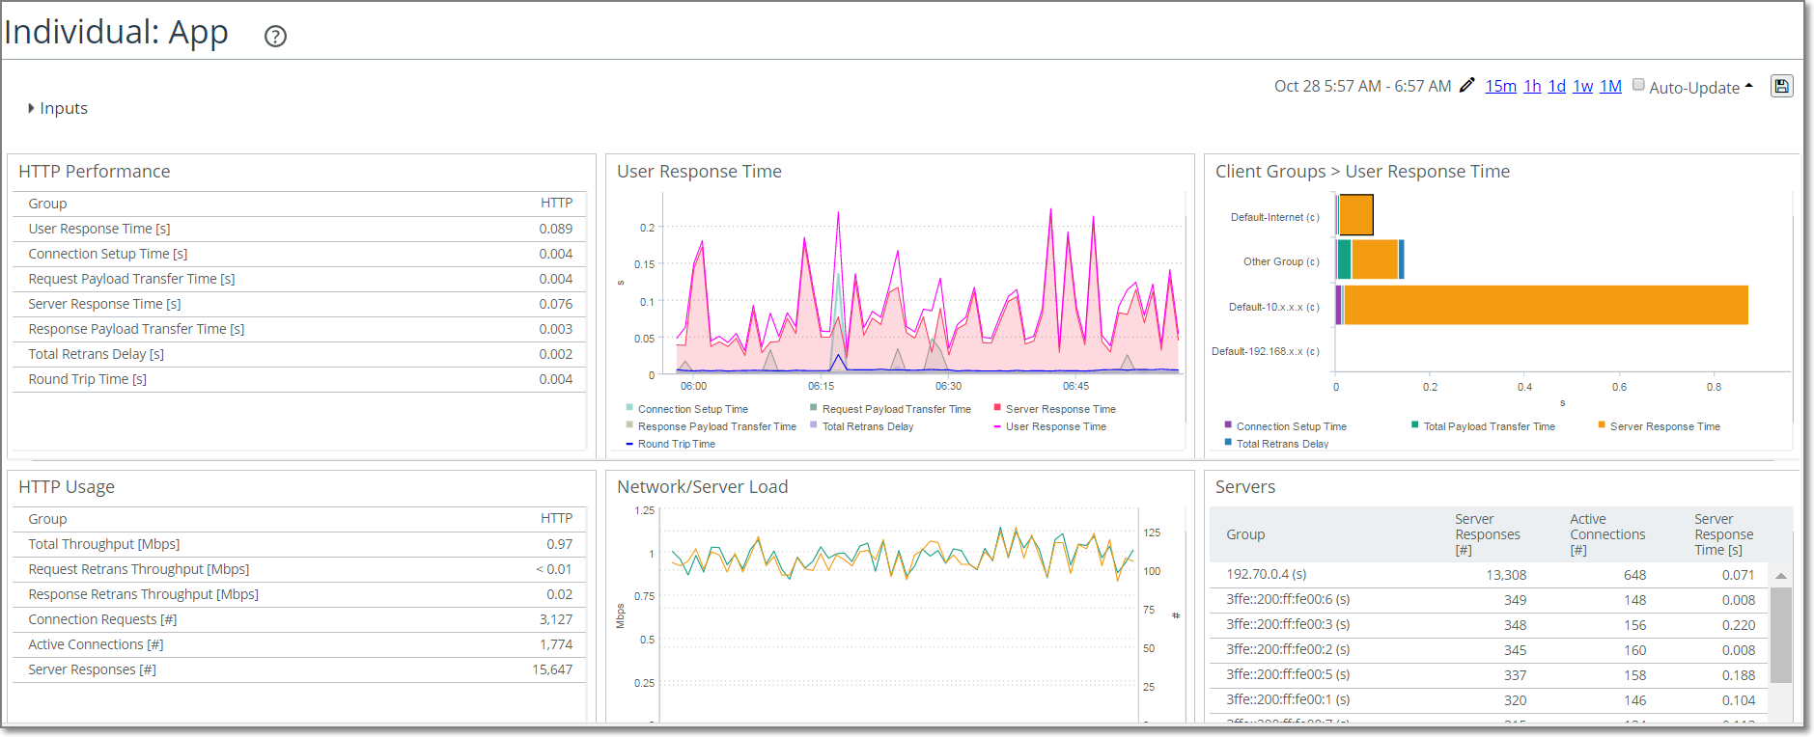
Insights
2H-16
Packaged info/workflows
M x N array of cards/panels
Focused on a specific subject/topic
Rich set of customizable cards
Contextual launch into deeper analysis

Slide 26
Insights (cont)
2H-16
What’s new and different?
Fully customizable content, and, presentation
Modify what we ship out of the box, or
Create your own from scratch (in Navigator)
Save and reuse your customizations
Your Insights, your names, your way
Sans complexity of “IDK”
Combine data from all data sources, e.g.,
Cards 1 and 2: Server delay and round trip time from ASA
Cards 3 and 4: Page time and page views from WTA

Slide 27
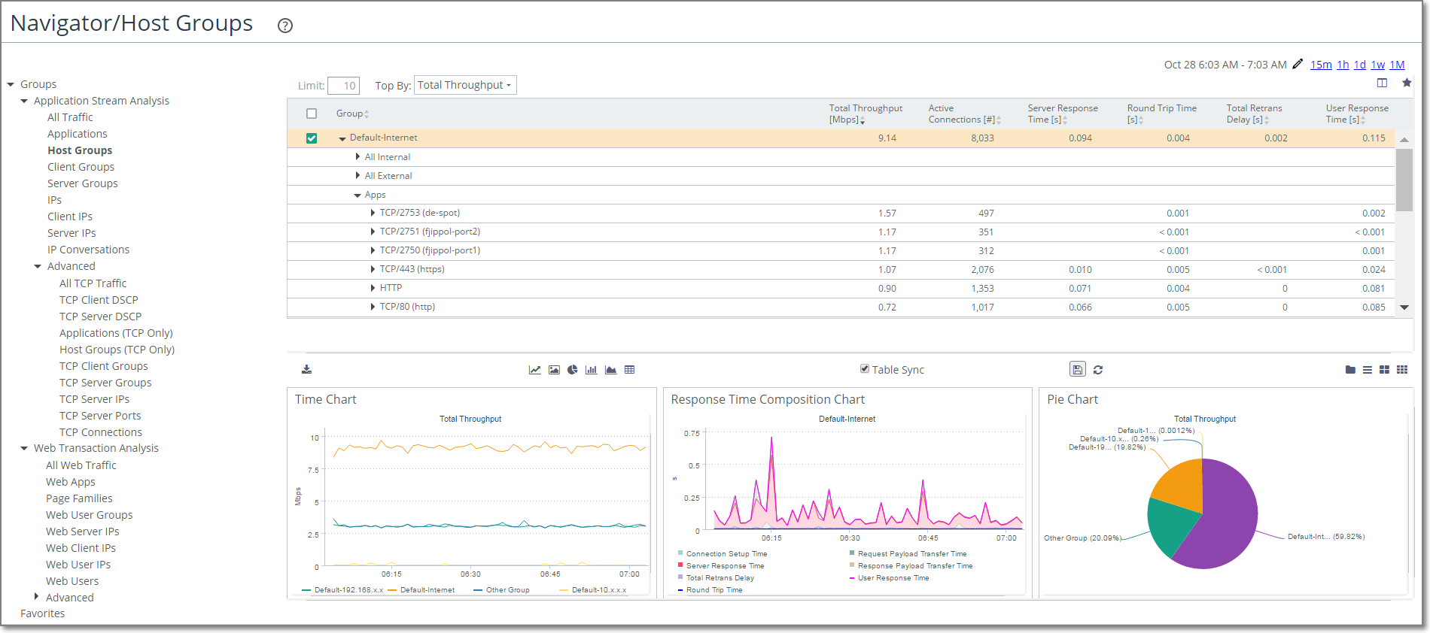
Navigator
2H-16
Validate your hunches. Explore and discover related factors.
Explore and discover
Build/assemble series of charts
Customize Chart Area content for Tree Table selection
Save info as templates and/or reports
Full support for Favorites

Slide 28
Misc. UI enhancements
2H-16
No limits on which info is combined in an Insight
E.g., combine ASA info with WTA info
New content in cards, e.g., geo data, individual web pages
Auto-complete support for HG and app names
…and lots more

Slide 29
New UI: Key Takeaways
2H-16
New, redesigned, and browser-based
Customizable Home view
More flexible Insights, and, greater data diversity
Navigator: Start anywhere, go anywhere, record everything
Streamlined Report creation, save anything you see

Slide 30
New UI: The Bottom Line
2H-16
More answers delivered faster
Make it easier to..
Find what I want – I don’t have time to memorize your UI
See information the way I want

Slide 31
Eagle: Enhanced ASA
2H-16
L4 response time analysis for all users, all apps, all the time
Performance and Scale
Up to 600 “Preferred” apps
2X increase!
Broader and richer performance data
New groups and drilldowns
Apps→Host Groups
…and lots more
Metric rationalization
No more “Server Response Time (Servers)”

Slide 32
Eagle: Enhanced ASA (cont)
2H-16
Out of the box application classification
Today in AppResponse
In AppResponse 11 Eagle..
Recognize 1300+ business and recreational applications, out of the box
10x increase in # of “recognized” applications!

Slide 33
Eagle: Enhanced ASA (cont)
2H-16
Richer data for quicker answers
App > Host Group
App > Host Group > Member IP
App > Host Group > Member IP > IP Conversation
App > Host Group > Connected IP
App > Host Group > Connected IP > IP Conversation
App > Host Group > IP Conversation
App > Host Group > Connected Host Group
App > Host Group > Connected Host Group > IP Conversation
..and lots more
App performance for server group A, user group B, etc
And performance for each server/user IP in server/user group
And performance for server/user IP conversation
And performance for each external IP each server/user IP talked to

Slide 34
Eagle: Enhanced WTA
2H-16
Bespoke performance analysis for web applications
Performance and Scale
Rearchitected engine
Analyze more HTTP(s) requests/responses, output more “pages” and transactions, etc.
Programmability and control
Full control of WTA logic/”rules”
Custom metric columns (up to five)
Broader and richer performance data
Advanced meta data extraction, browser type, geo location, workstation OS
Better isolation of unexpected behavior, e.g., track 400-404, 500-503

Slide 35
Eagle: Enhanced WTA (cont)
2H-16
Programmability and control
You have more control over:
Which objects start a page, are used or ignored, etc.
More control over Page Families
How PF names are derived
More control over Web Applications
Which pages belong to a web application
New knobs for control:
Request/Response headers
URL parameters/fields
SOAP headers.. and more

Slide 36
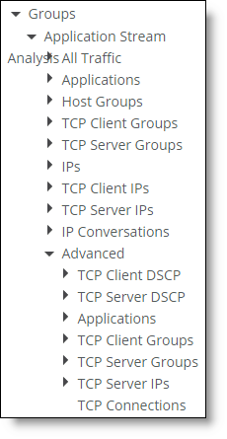
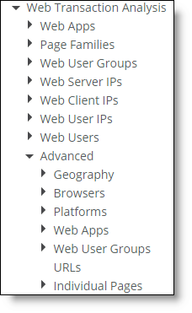
Eagle: Alerting Enhancements
2H-16
Alertable Groups: 3x Increase!

Slide 37
Eagle: Alerting Enhancements
2H-16
Enhanced alerting logic
E.g., Alert me when:
Avg 5-min server delay for MyCriticalApp, for users in MyLocations 1, 2 and 3 goes beyond 5 seconds, and
When this happens at least twice in twenty minutes
You can do this today
In addition, you can also do this in Eagle

Slide 38
Transition to AppResponse 11: Learn, Plan, Execute
For AppResponse and NetShark customers
Each quarterly AppResponse 11 release:
Available as Virtual Alloy Free Trial for all maintained customers
Goal: Test and learn Alloy before adoption
Eagle
Eagle+
Falcon
Gripen
Harrier
Q4-16 | Q1-17 | Q2-17 | Q3-17

Slide 39
AppResponse 11 Eagle+ - GA

Slide 40
Eagle+ (11.0.1) Overview
Flow export
Enhanced flow to NetProfiler version 10.9.5 (or later)
Standard v9 Netflow to standard flow collectors
Up to two exports
Virtual Edition support (details on next slide)
Licensing with feature keys required for add-on modules
Packet Broker Integration support*
Accepts timestamps and/or packet-slicing headers from a number of PBs
cPacket, Gigmon GigaSMART and H Series; Ixia/Anue; Arista
* AppResponse11 can support any packet broker that delivers packets to it; but will only recognize special fields from this list

Slide 41
Virtual AppResponse 11 Models
Four models
Models are determined by licensing
Web UI header display indicates model as well (VSCAN-xxxx)
Model | SKU | Flow Export | Packet Storage | ASA/WTA
100v | VSCAN-0100 | 50k fpm | 100GB | Y
500v | VSCAN-0500 | 100k fpm | 2TB | Y
2000v | VSCAN-2000 | 200k fpm | 8TB | Y
Flow | VSCAN-FLOW | 400k fpm | 100GB | N

Slide 42
Licensing of AppResponse 11 and Packet Analyzer+
Uses the Common Licensing Management Framework (CLMF)
CLMF uses a licensing server to provide Feature Keys to AppResponse 11 and Packet Analyzer Plus
Licensing server is Riverbed-hosted, publically accessible, owned by IT
Feature Keys are strings to allow/disallow a feature and are added either
Automatically over the internet
Manually through human intervention
Software components check Feature Keys to confirm licensed use

Slide 43
AppResponse 11 Licensing Flavors
In AppResponse 11.0.1 there are two types of license
Node-locked — used for physical appliances, tied to Riverbed serial #
Feature keys are computed solely from serial #
At boot an attempt is made to acquire a license
Single-seat — used for virtual appliances - not tied to single system
Uses a product key to generate an activation key to activate the software
Product keys can be released and reassigned to other systems
Deactivation is required before moving to a different system

Slide 44
Packet Analyzer Plus Licensing Flavors
Packet Analyzer Plus 11.0.1 supports single-seat licenses only
Uses the Common Licensing Management Framework (CLMF)
A single-seat license gives the user a product key
Activating a product key generates an activation code
This code uniquely identifies the physical machine where activated
Contains product key and session ID (to uniquely identify activation session)
This happens automatically in the “connected” or “online” case
A product key can only be used in one machine at a time
Users may deactivate the single-seat license
After deactivation the license may be re-activated on a different system

Slide 45
Packet Broker Support Overview
External packet brokers allow for:
Precise timestamping
Slicing of packets (provide original packet length pre-slice)
Lower bandwidth of the input to the AppResponse appliance
Headers/trailers added by packet brokers will be parsed/stripped
Packet brokers may deliver packets (slightly) out of order
AppResponse will sort the packets automatically

Slide 46
Supported Packet Brokers
Physical supported vendors and types of header/trailers are:
gigamon_header* (available on GigaSmart blades), slicing supported
gigamon _trailer(available on GigaSmart blades), slicing supported
gigamon_x12 (available on Gigamon H-series)
cpacket_ts_only
cpacket_ts_and_slice, slicing supported
anue, slicing supported
arista (3 modes of operation, automatically detected)
Virtual appliances offer support for gigamon_headers only

Slide 47
AppResponse 11 Falcon заверните

Slide 48
Falcon: High-level Content
Shifting sales from legacy to AR11
NetShark Customer Transition
RADIUS and TACACS+ authentication
AR9 Customer Transition
Upgrades for models 2200, 3300, 3800
Archive of pre-AR11 performance data (for both upgrades & Trade-up)
Import scripts for pre-AR11 BG➔HG and applications
Portal integration

Slide 49
Falcon: High-level Content (continued)
New feature/function
Scale – Model 8170 Early Availability
Provide customers wanting our “biggest box” the chance before 8170 GA
While not “GA performance”, the 8170 will still be our highest performing appliance
Data Base Analysis (DBA) module. DBs supported:
IBM DB2 LUW 8.0 through 9.7
IBM DB2 on AS/400
IBM Informix 7.30 through 12.10
Microsoft SQL Server 2005, 2008, and 2012
MySQL 5.0 through 5.5
Oracle 8.1.7 through 11gR2
Sybase ASE 11.9.2 through 15.7
Teradata V2R5.0 through 15.10

Slide 50
Falcon: High-level Content
UI / Policies Enhancements
UI Interactivity for
Group Selection
Selected Widget “item”
Time Series Selection
Lock/Unlock between Navigator Tree Table and Workspace
Top/Specific group choice for Navigator Widgets
“True Plot” time chart for TDS transactions
Policies: Set-of and Any for IP conversations

Slide 51
Falcon/Gripen/Harrier: Updated Platforms
2H-17

Slide 52
Falcon: Application Intelligence
1H-17
DB module: Full “citizen” status
New groups drilldowns
Support for newer DBs, e.g., SQL Server 2014, DB2 on AS/400, etc.
All metrics available for alerting, reporting, dashboarding

Slide 53
NetIM когда ж…

Slide 54
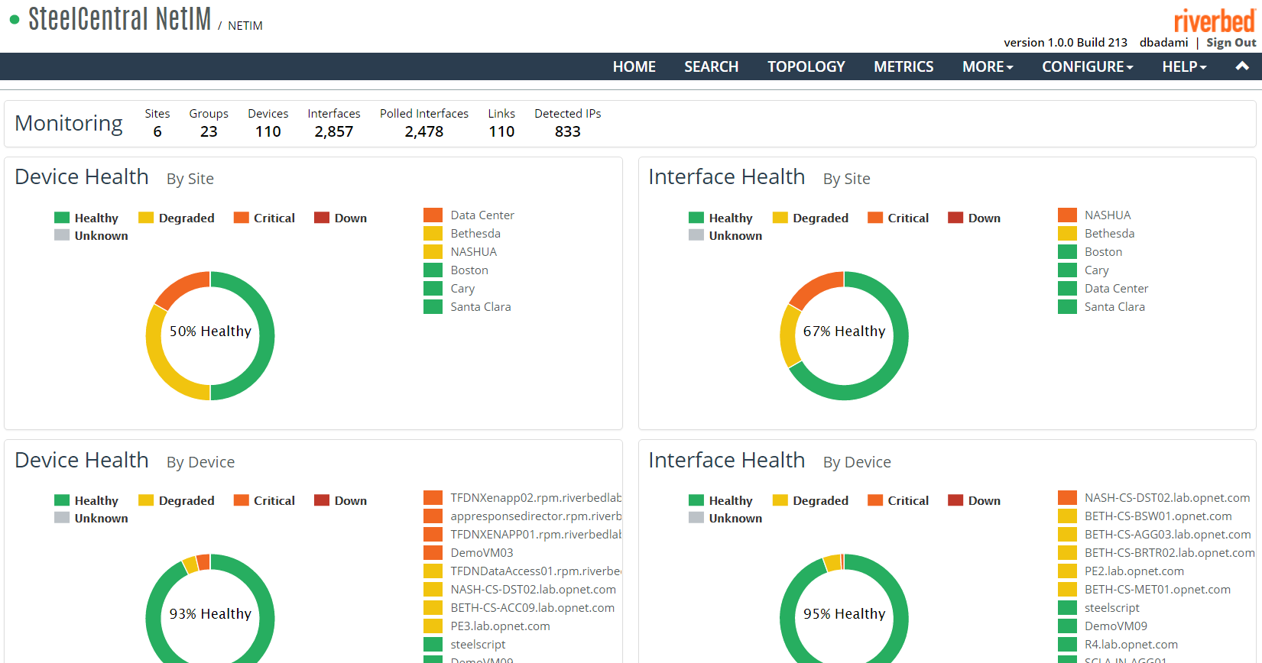
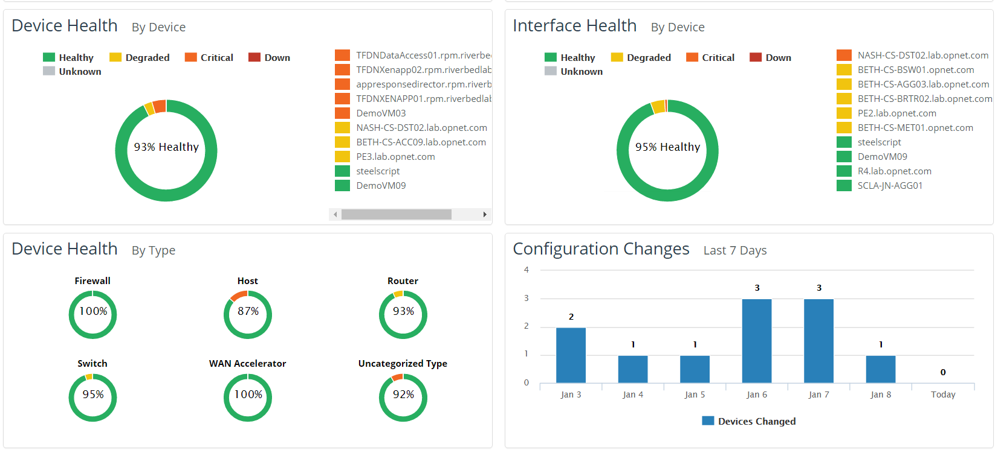
Notes:
Home Page with the NOC view of the health of your entire network
1- Home page, 2- home page continued

Slide 55
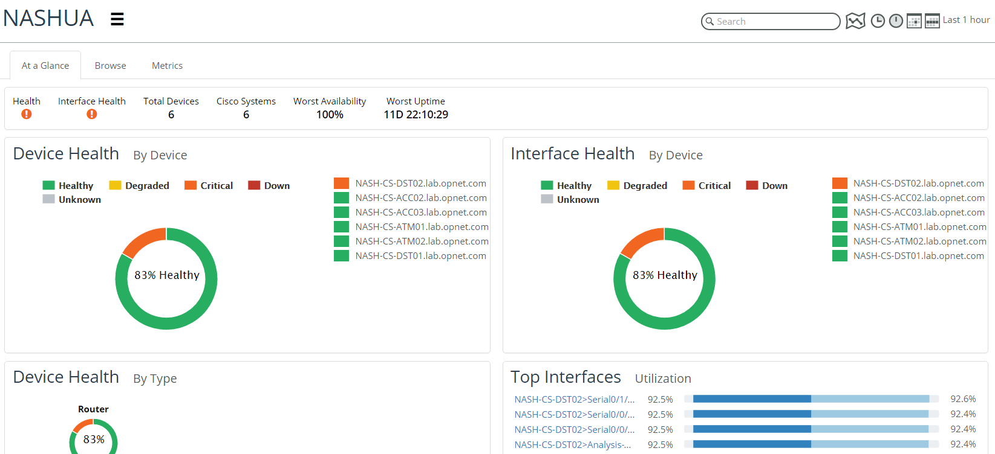
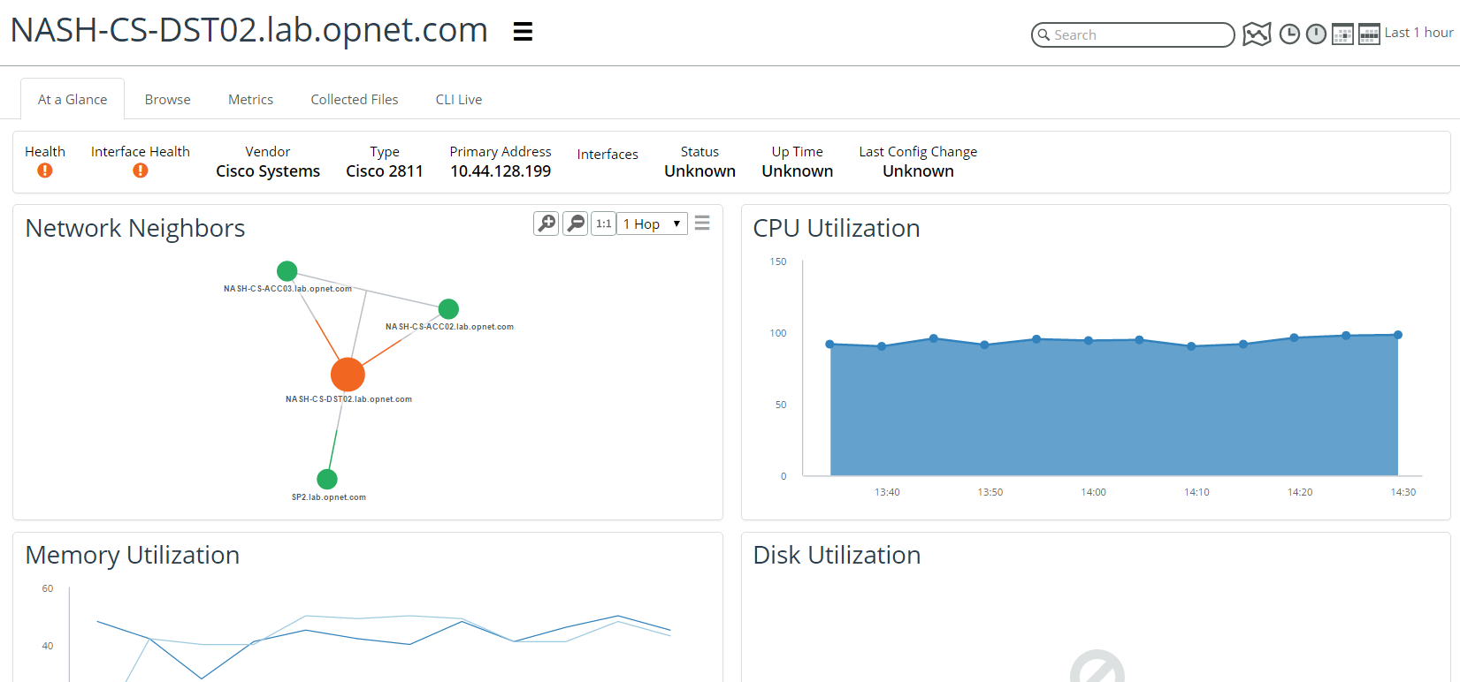
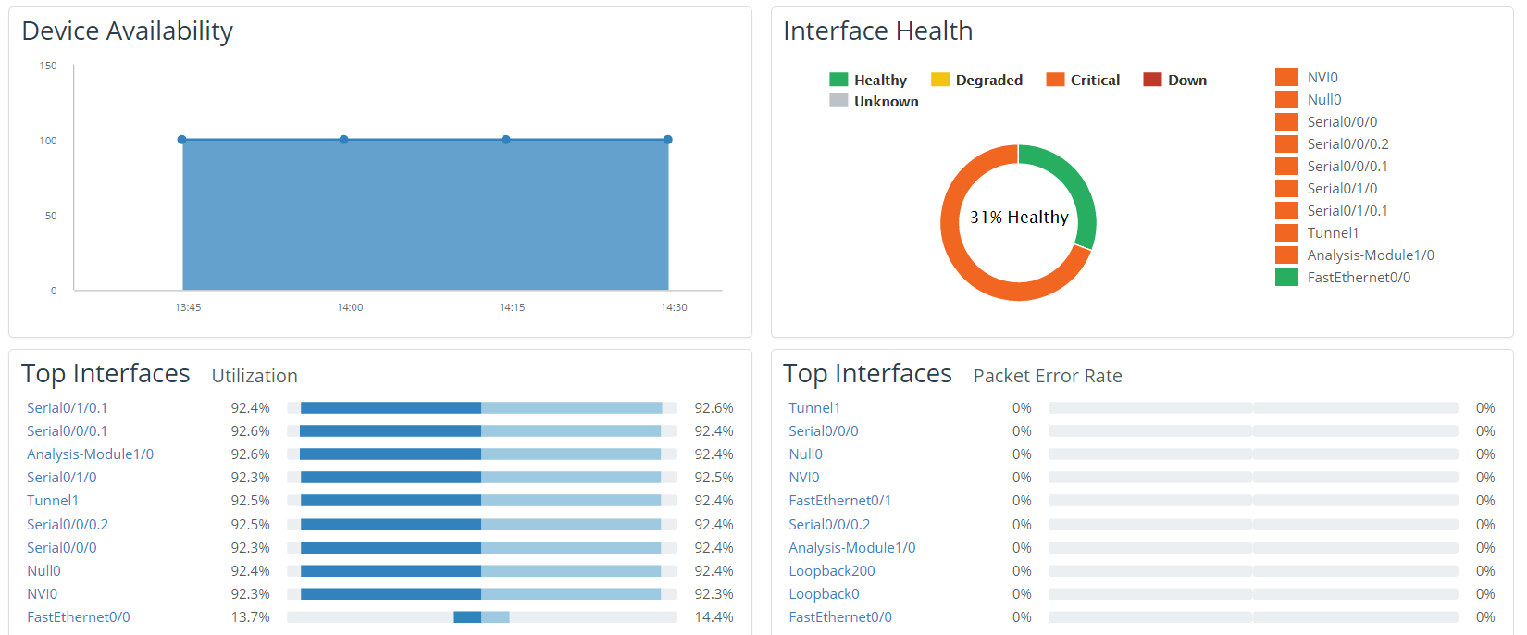
Site level details
Device level details
Notes:
1- Site level view worst performers for the site, 2 – drill down into a node, 3 – node stats continued

Slide 56
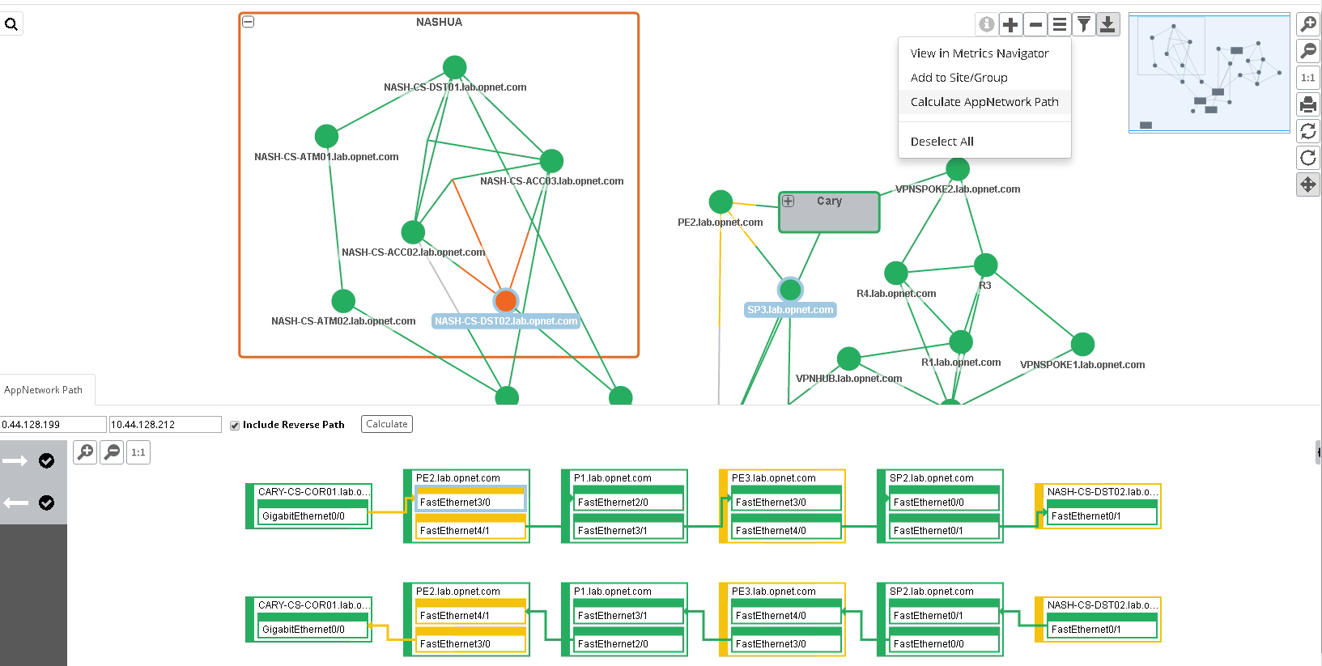
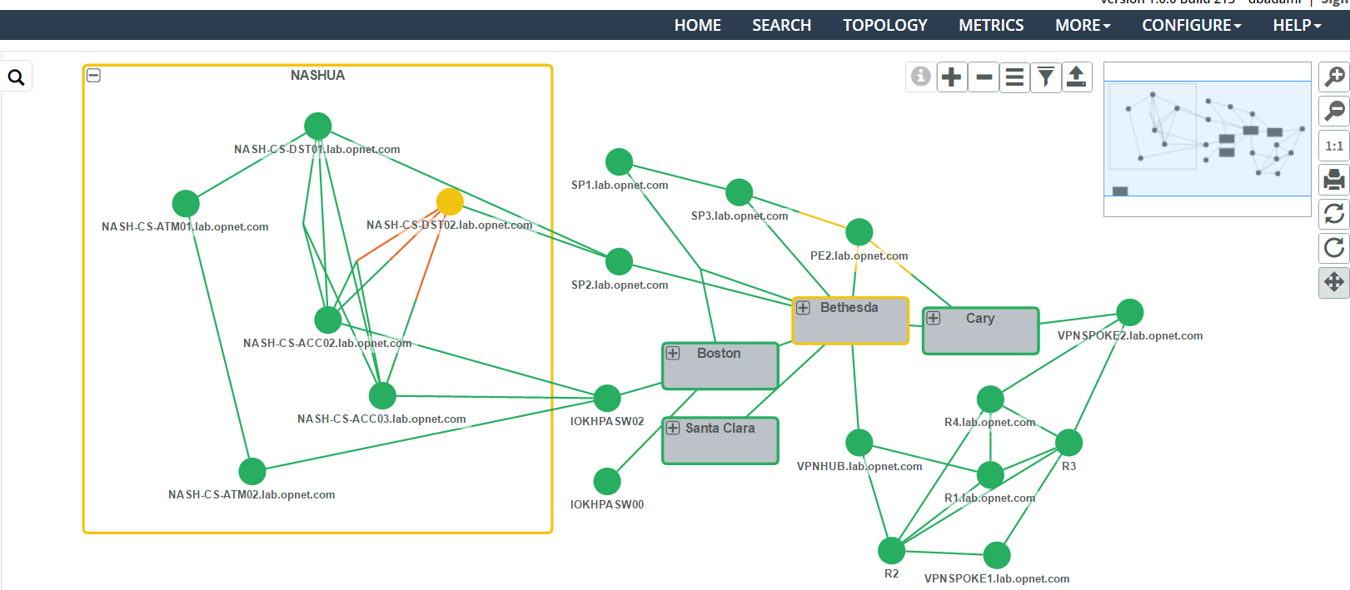
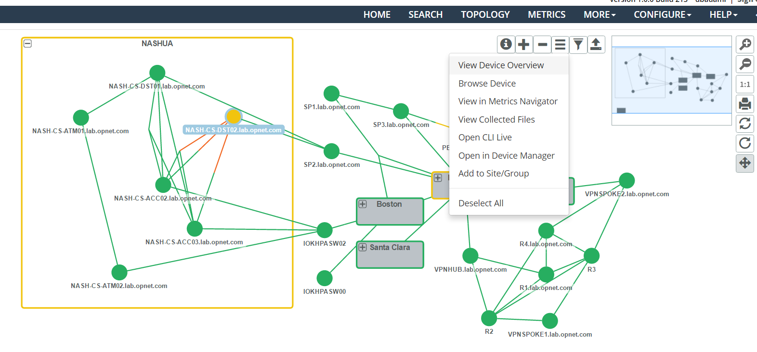
Notes:
Topology view and appnetwork path from Topology view

Slide 57
Notes:
AppNetwork Path from home page

Slide 58
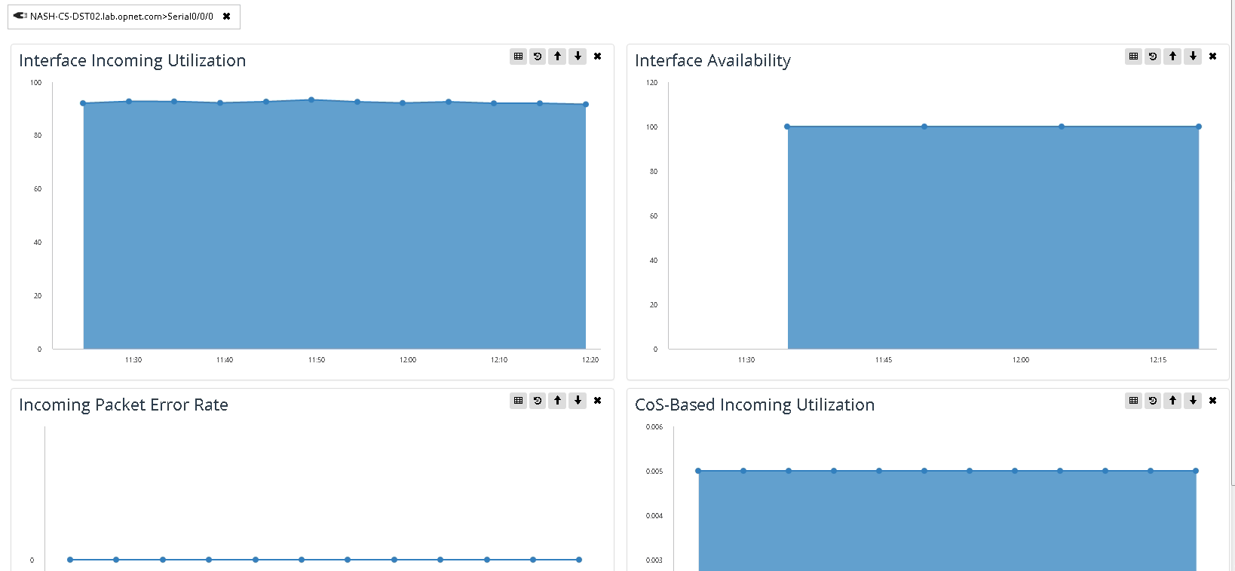
Metrics Navigator

Slide 60
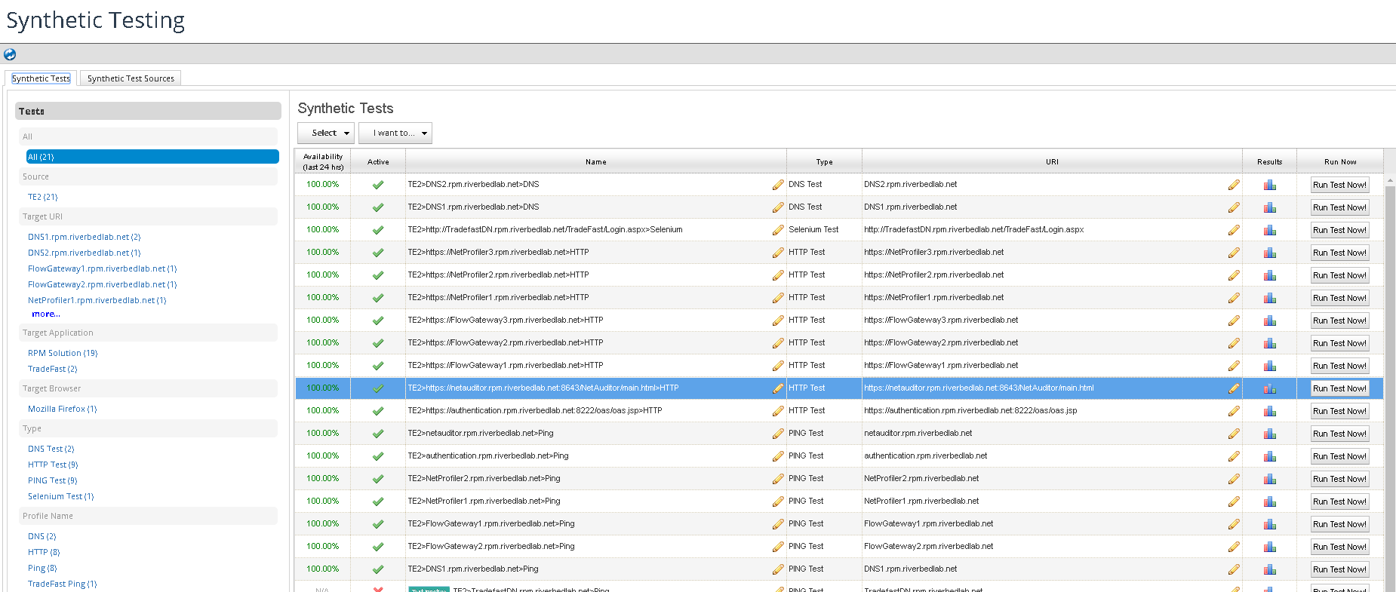
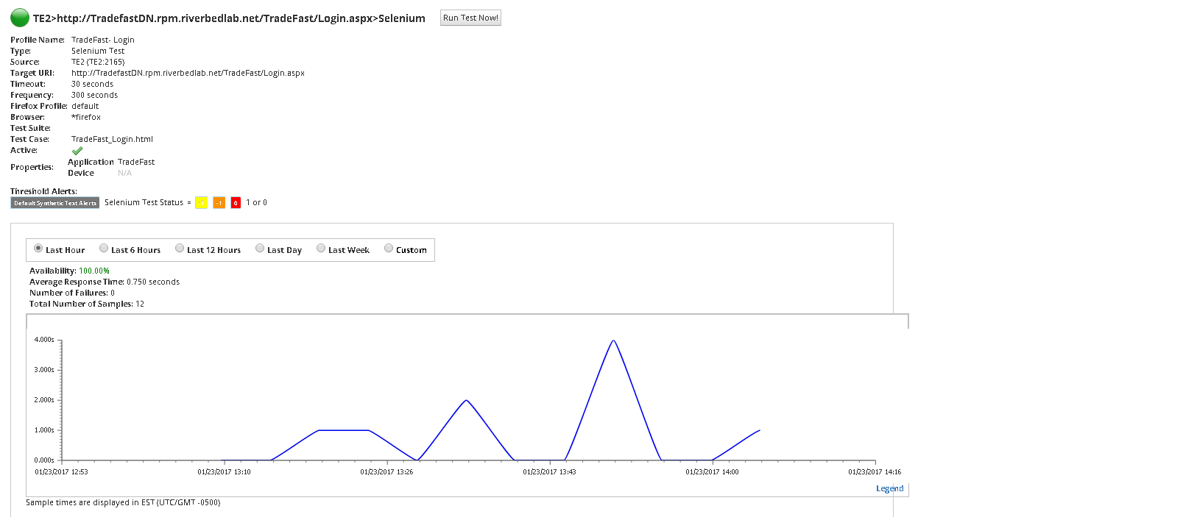
Notes:
1) Synthetic Test types, 2 – Synthetic Test Results

