Slide 1
Обзор продуктов

Slide 2

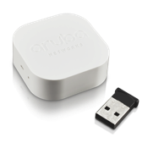
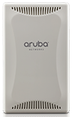

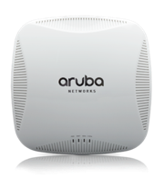
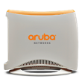
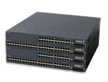
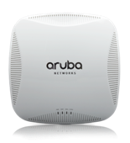

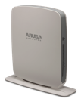
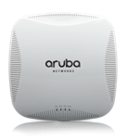
Продукты: Сети
Наружные точки
Гостиницы и медицина
Bluetooth
205H
3 порта
802.11ac
AP-103H
2 порта
802.11n
Aruba Beacons
Внутренние точки
RAP
Коммутаторы
AP-220
Высочайшая плотность, 1.7 Gpbs
RAP-3
3 порта
S3500
24, 48 портов
High-end
AP-210
Стандарт для офиса
1.7 Gbps
RAP-109
2 порта
S2500
24, 48 портов
Привлекательная цена
AP-200 Низкая плоность
1 Gbps
RAP-155
4 порта
S1500
12, 24, 48 портов
Филиалы
Notes:
Instant APs + Hospitality APs
Services, Management, Connectivity all in three separate slides.
Meridian is part of services
All with their software modules highlighted1. 100% of growth year over year… compare against Aerohive, Ubiquiti, Meraki, Ent WLAN, Aruba… customer wins + tech features
2. With central it becomes an unbeatable product…
3. Use cases
4. Single architecture slide

Slide 3


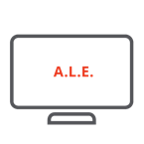















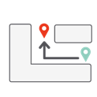
Продукты: Сетевые сервисы
Безопасная мобильность
Гибкая политика
Аналитика
Контентная фильтрация
Policy Manager
AAA, RADIUS, CA, Profiling, Exchange, Auto Sign-On, TACACS+
ALE & Панель аналитики
RFP
Анализ спектра, WIDS
Вовлечение
PEFNG
App Firewall
Гостевой доступ
Брендирование, Реклама
Meridian AppMaker
7200
Кампусы
Onboard
BYOD
Meridian BluDotKit
7000
Филиал
Meridian ZoneKit
Onguard
NAC
Виртуальный контроллер
Aruba Instant
Meridian NavKit
Notes:
Instant APs + Hospitality APs
Services, Management, Connectivity all in three separate slides.
Meridian is part of services
All with their software modules highlighted1. 100% of growth year over year… compare against Aerohive, Ubiquiti, Meraki, Ent WLAN, Aruba… customer wins + tech features
2. With central it becomes an unbeatable product…
3. Use cases
4. Single architecture slide

Slide 4
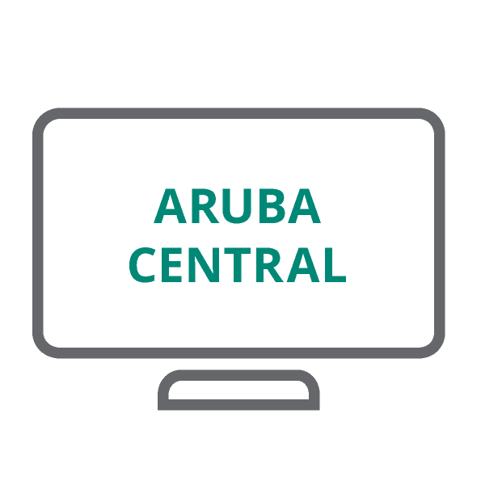
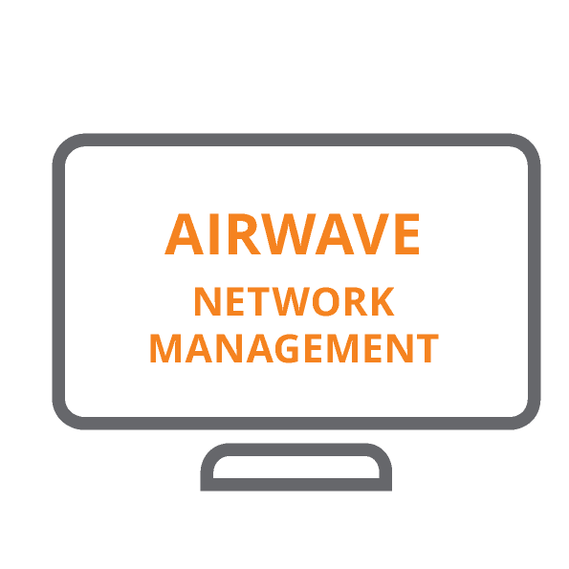
Продукты: Управление
Облачная
Локальная
Central
Instant, Коммутаторы
Гостевой доступ, MDM
Visual RF, WIDS,
отчеты
AirWave
Aruba & другие вендоры, Visual RF, WIDS,
отчеты
Notes:
Instant APs + Hospitality APs
Services, Management, Connectivity all in three separate slides.
Meridian is part of services
All with their software modules highlighted1. 100% of growth year over year… compare against Aerohive, Ubiquiti, Meraki, Ent WLAN, Aruba… customer wins + tech features
2. With central it becomes an unbeatable product…
3. Use cases
4. Single architecture slide

Slide 5
Транспорт

Slide 6
Гибкостро развертывания
Контроллер
Без контроллера (Instant)
Централизованная обработка
Большие домены мобильности
Масштабирование сервисов
Индивидуальные удаленные площадки
Упрощенное управление
Минимизация затрат
CONTROL
+ DATA Plane
Instant
Instant
Controller
AirWave
Central
Крупнве сети, множество филиалов
Управление контроллерами и коммутаторами
Мультивендорность
MANAGEMENT
Облачное управление
Простая настройка и поддержка
Много независимых филиалов
Notes:
Aruba is the only vendor that gives customers the ultimate in choice for both the Control/Data Planes as well as the Management Plane.
For larger campuses, such as a university or large enterprise, controllers tend to make the most sense. They are able to handle massive amounts of traffic and huge numbers of devices while reducing the roaming re-authentication load. A site with complex network topologies, such as multiple VLANs, benefits from the centralization of the network design.
On smaller sites or campuses, such as retail or primary schools, controllerless deployments make sense. These independent entities don’t generally have the complex network requirements and costs need to be reduced. These sites typically operate independently of a centralized site, or use site-to-site VPNs for connectivity.
And if a customer starts out as a smaller campus and grows in size to where a Controller would make more sense, only Aruba allows customers to reused their AP’s and convert them from controller-less to controller-based. Customers don’t need to buy new Access Points.
On the management plane, customers can choose between a cloud-based management system with Aruba Central or for larger customers that either have Controllers in the network or have many branches of controllerless APs they can deploy AirWave onsite.
Aruba Networks enables deployment flexibility.

Slide 7
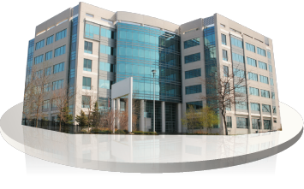


Формула успеха
Кампус
Филиал
SME
  7200
  Airwave
  S2500/3500
  115/225
Instant
Airwave
S1500
115/225,
& 109/155
Instant
Central
115/225 APs
Высокая производительность, Высокая надежность Wi-Fi
Notes:
Tout our high performance, high-reliability story. With Aruba, we position the same access points no matter if it’s a campus, branch, home or mid-market deployment.
CAMPUS
Position the 7200s for large campuses with wired complexity
AirWave for switch management and multivendor
Pitch the S2500/S3500 to amplify the Aruba policy story
Pitch the 115/225s for WLAN
BRANCH
Lead with Instant instead of controllers
Manage this with AirWave, based out of the Campus
Position the S1500s for switches
And the 115/225s or RAPs (desktop)
MID-MARKET
This is our channel-led market for Instant. Smaller deal sizes, with <1000 employees.
Cloud Management with Central is the key here
Position the 115/225s or fall back to the 103/5

Slide 8
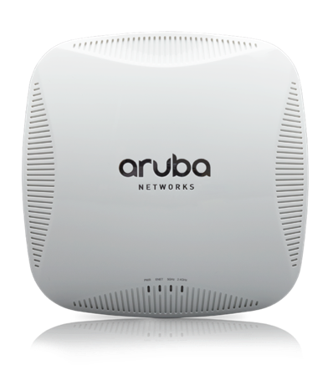
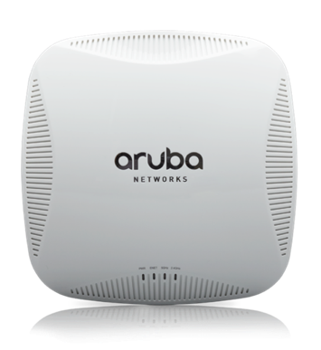
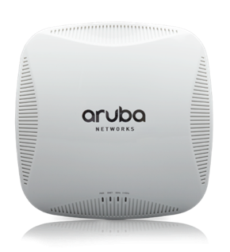
Портфолио 802.11ac
220 Series
210 Series
200 Series
1,300 + 450 Mbps
3x3:3SS, 1xGE, USB
867 + 300 Mbps
2x2:2SS, 1xGE port
1,300 + 450 Mbps
3x3:3SS, 2xGE, USB

Slide 9
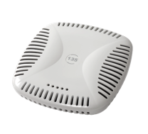
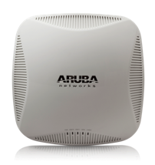
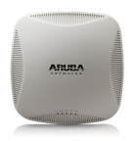


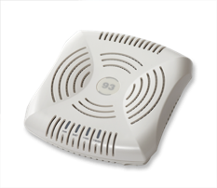
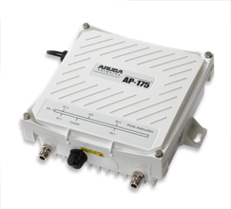
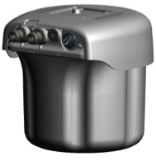
Миграция с 802.11n на 802.11ac
120 & 130
220
110
210
90 & 100
200
175
270

Slide 10
Выбор решения 802.11ac
Модель | Расположение | Производительность | Плотность | Вертикаль
200 | Внутренняя | Средняя | Средняя (50 активных) | Школа Склад Ритейл
210 | Внутренняя | Высокая | Средняя (75 активных) | Офис
220 | Внутренняя | Высокая | Высокая (125+ активных) | Университет Публичная Арена
270 | Внешняя | Высокая | Высокая (125+ активных) | Внешняя инсталляция
Notes:
Entry: 200 Series → moderate performance & density
Cost-sensitive deployments with moderate performance and moderate density (up to 50 active devices per AP)
Aggressive pricing, simple transition from 11n (AP-105), 2x2:2SS
Flagship: 220 Series → highest performance & density
High-density (up to 125 active devices per AP) and highest performance while also providing redundant GigE uplinks.
Premium platform, best in the business
Mid range: 210 Series → high performance & moderate density
High performance but willing to sacrifice on density of users (up to 75 active devices per AP) and forgo redundant GigE uplinks for cost savings. Full performance on 802.3af.
Cost-effective, high performance, value

Slide 11
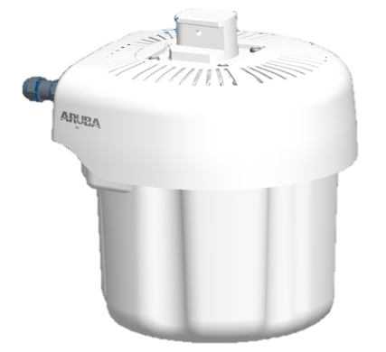
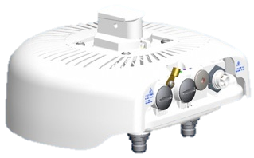

Aruba AP-270 802.11ac
IAP/AP-275
Интегрированные антенны
IAP/AP-274
Внешние антенны
Инсталляция: Просто
Дизайн: “Уличное оборудование”
Температура: -40°C to +65°C
Питание: AC or PoE+
Notes:
Same core design and performance as 220 Series but industrial-grade version of components for outdoor reliability.
Installability
Installer skill set identical to installing video cameras
2 Parts vs up to 11 parts
No weather proofing required for AP-275 install
AP-274 provides protected connector interfaces.
IP66 and IP67 rated
Deployability
Multiple bracket solutions
Advanced filtering allows for co location with traditional cellular, 2.3 and 2.5/2.6 GHz LTE solutions

Slide 12
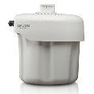

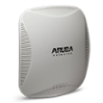



Aruba Instant
Двойной аплинк*
Поддержка 4G*
VPN
100% выживаемость
Бюджетное решение
Популярное решение
Высочайшая
производительность
Внешнее покрытие
Instant 103
Dual radio 802.11n
2X2:2SS
300 Mbps
Instant 3
Single radio 802.11n
2X2:2SS
300 Mbps
Instant 114/115
Dual radio 802.11n
3X3:3SS
450 Mbps
Instant 108/109
Dual radio 802.11n
2X2:2SS
300 Mbps
Instant 224/225
Dual radio 802.11ac
3X3:3SS
1.3 Gbps
Instant 155
Dual radio 802.11n
3X3:3SS
450 Mbps
Instant 274/275
Dual radio 802.11ac
3X3:3SS
1.3 Gbps
*для настольных точек
Notes:
The AP-110 Series and AP-220 series are our latest generation of Wi-Fi products and both have RF enhancements that include cellular interference mitigation as some of the LTE cellular bands can interfere with 2.4GHz transmissions on the 11n radio.
You should lead with the AP-220 Series for high performance and density, upselling your customers from the AP-130 to AP-220.
For cost-sensitive customers or those who don’t need the best performance and future-proofing, lead with the AP-110 Series.
AP-103
Price TBD, in range 395-495; March 2014 target release
AP-224/225
3x3:3 Dual Radio
5GHz 11ac: up to 1.3Gbps
2.4GHz 11n: up to 450Mbps
2x GE link aggregation
Enabling >1Gbps throughput
Full 802.11ac functionality with standard 802.3af PoE
802.11ac Beamforming

Slide 13
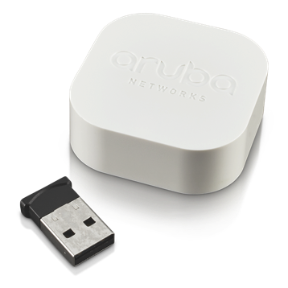


Aruba Beacons для определения местоположения
NEW
  Совместимо с iOS и Android, поддерживающими iBeacon
  Бюджетно
  Высокая точность (<1m) и низкая задержка (<2sec)
  Инструменты для развертывания и мониторинга

Slide 14
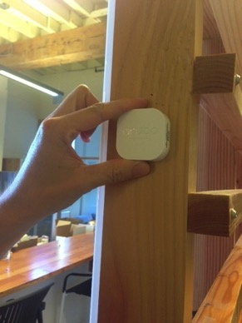
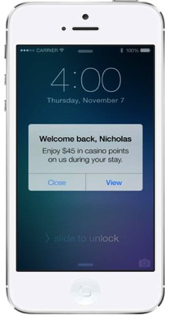

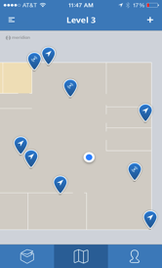
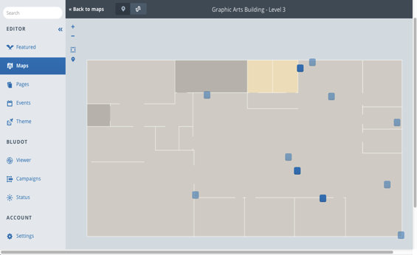
Полный инструментарий
NEW
NEW
Два исполнения
Питание от батареи
Питание от USB
Позиционирование на карте
Приложение «Aruba Beacons»
Meridian для управления
Заряд батарей
Статус
Обновление ПО

Slide 15
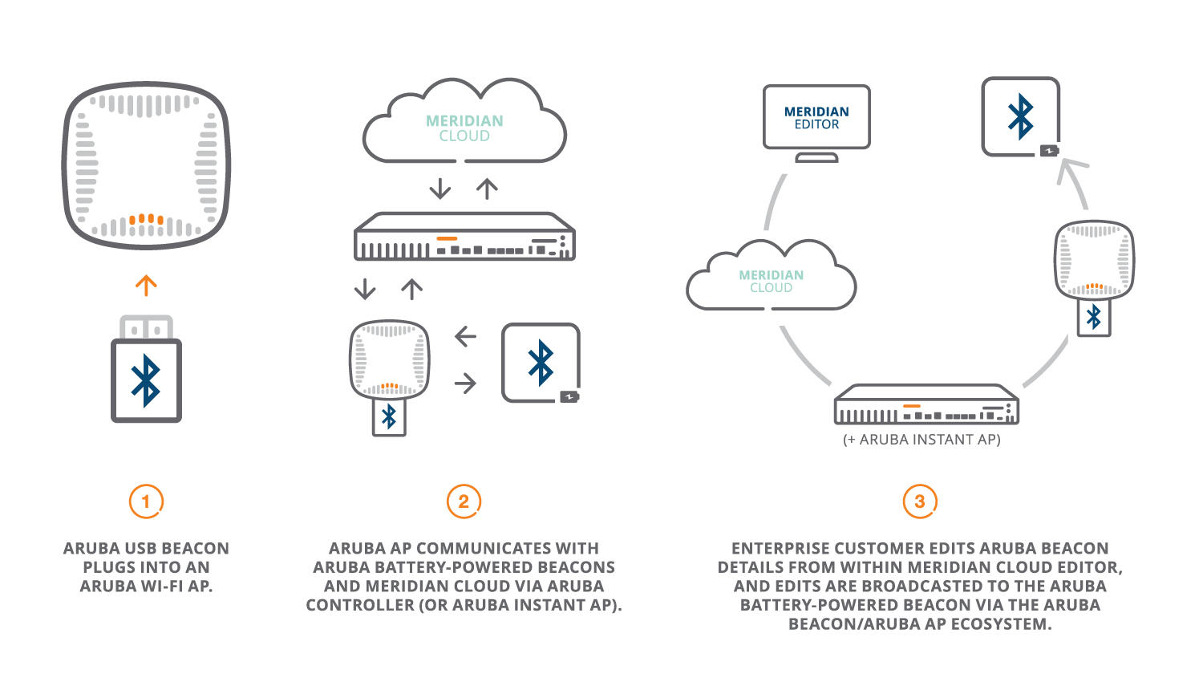
Как Wi-Fi помогает управлять
NEW

Slide 16
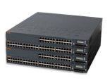
Коммутаторы мобильного доступа
S3500-24P/48P
4x 10GbE uplink
1440W
Модульные блоки питания и вентиляции
L2/L3
S2500-24P/48P
4x 10GbE uplink
400W
L2/L3
Цена
S1500-24/48P
4x 1GbE uplink
400W
L2/L3
S1500-12P
2x 1GbE uplink
100W
L2/L3
Производительность
Notes:
The Aruba Networks Mobility Access Switches are the only wired network solution designed for mobility.
In addition to built-in Layer 2, Layer 3, site-to-site VPN and authentication capabilities, the Mobility Access Switches extending the unified role-based access to wired users and devices so that a customer can define common policies that apply for wired and wireless. This delivers consistent and secure access to network resources for both wired and wireless users.
Our recently released S1500 platform reduces the barrier for a customer to purchase and evaluate Aruba wired access. The S1500 series do not have some of the hardware capabilities of the S2500/S3500, but it is feature compatible with its big brothers… zero-touch provisioning from Aruba Activate, wired port security, tunneled ports to a centralized Aruba controller, integration for VLAN configuration and rogue AP detection with Instant APs and others… these unique features can all be demonstrated using the S1500-12P platform, which is the size & weight of a standard laptop.
The number one question you are going to get is, how easy it is to use the switches? If someone has Cisco switching training, it will be a walk in the park. They just need to see it to believe it.
S1500 does stack with software release 7.3; you can stack S1500 with other S1500s (only). Even the 12-port can stack, which is actually a use case by two customers (two switches in a retail store that act as a single logical device). You cannot mix S1500 and S2500/S3500 in a stack, however.

Slide 17
Сервисы мобильности

Slide 18







Портфолио контроллеров мобильного доступа
Филиалы
Кампусы
7030
64 AP
4K устройств
8Gbps FW
7240
2048 AP
32K устройств
40Gbps FW
7024
32 AP
2K устройств
24 POE Ports
4Gbps FW
7220
1024 AP
24K устройств
40Gbps FW
7010
32 AP
2K устройств 12 POE
4Gbps FW
7210
512 AP
16K устройств
20 Gbps FW
7005
16 AP
1K устройств
2Gbps FW
7205
256 AP
8K устройств
15 Gbps FW

Slide 19
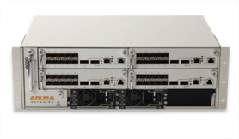

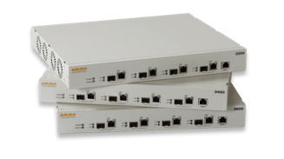
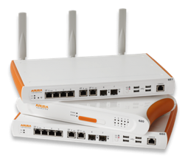
Пути миграции
6000
7200
3000
7030 & 7024
600
7005 & 7010

Slide 20





Aruba ClearPass
Guest
Onboard
OnGuard
ClearPass

Slide 21







ClearPass: безопасность на 360 градусов
Унифицированная политика
Контекстно-ориентированная политика
Профайлер
PKI
EMM / MDM
NAC
Token
Автоматизация процессов
TACACS
ClearPass
AD/
LDAP
RADIUS
Гостевой доступ
SQL
Мониторинг
и контроль
Регистрация устройств
Проводная и беспроводная
безопасность
Notes:
Aruba ClearPass addresses the needs of the ever-changing policy landscape, replacing the point solutions and management headache with one comprehensive, secure, robust Policy Management Platform. This not only lowers CAPEX/OPEX but allows the creation of finely tuned security policies with the emphasis on simplicity and an enhanced user experience.

Slide 22









ClearPass изнутри
Лидер индустрии безопасности и контроля доступа
Мониторинг
Автоманизация
Политика
Профайлинг
Онбординг
Ролевой доступ
Диагностика
Управление гостями
NAC
Отслеживание
сессий
MDM
интеграция
Учет контекста
Notes:
To eliminate silos Aruba ClearPass is designed to deliver user and device visibility, automated workflow services and policy management enforcement all from a single platform.
Built-in device profiling provides a comprehensive picture of what’s connecting to the network which makes it simple to differentiate access for BYOD and IT managed devices. Real-time troubleshooting tools help IT create policies that work and also solve connectivity issues. For example, an access dashboard and per session logs allow IT to easily see why a user had a problem without having to peruse lengthy log databases.
To help off-load IT, ClearPass includes automated features that allow users to self-provision personal devices and register media sharing devices like an Apple TV or just a printer. ClearPass Guest lets visitors self-register or sponsors can create credentials that automatically expire. Device management services extend MDM capabilities with network control and enforcement. A built-in CA can be used to distribute and manage device specific certificates. User can even re-install or revoke certificates for lost or stolen devices.
The policy component brings it all together by allowing organizations to create granular policies for Aruba and multivendor Wi-Fi, wired and VPN networks. A role-based model allows you to assign and differentiate access by user, device and other contextual attributes like location, job function and device ownership. All this from a single pane of glass.

Slide 23

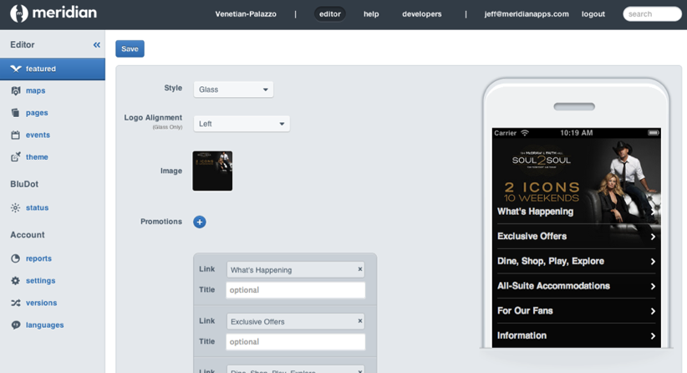

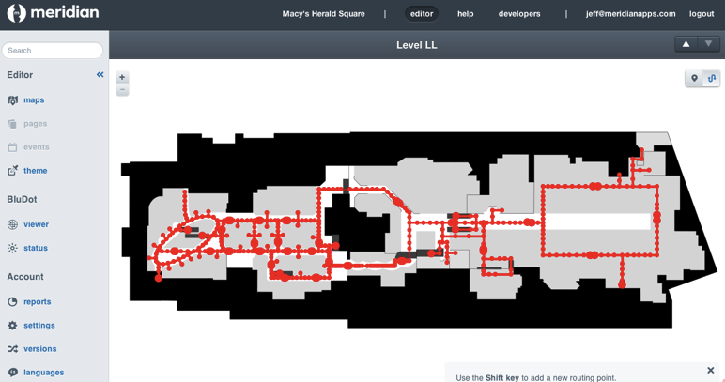
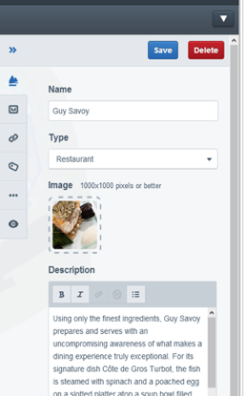
Meridian
Облачная платформа для управления контентом
Интегрированный инструментарий для вовлечения посетителей на основе местоположения

Slide 24
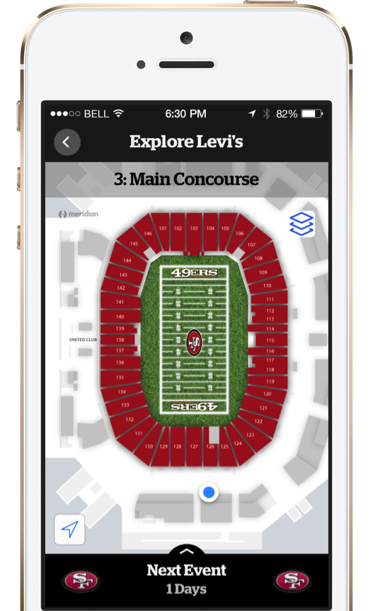



Meridian SDK
Levi’s Стадион работает с Meridian SDK
1,000+ Aruba Beacons
2,100+ Заказов еды через приложение на первой игре
Beacon SDK
BluDot SDK
NavKit SDK

Slide 25

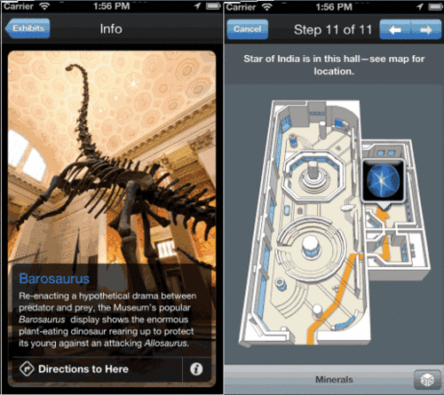
Поиск Маршрута
  Как это работает?
  Meridian используется для создания POI.
  Aruba Beacons помогают приложению Meridian определять местоположение.
  «Синяя точка» появляется на карте.
  Точная информация о координатах помогает вести пользователя.

Slide 26
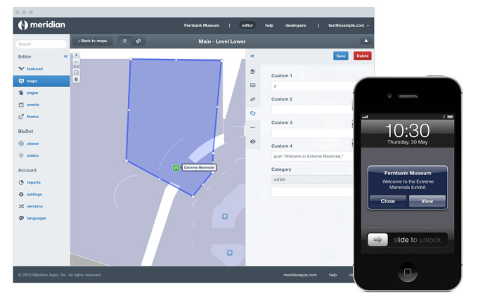
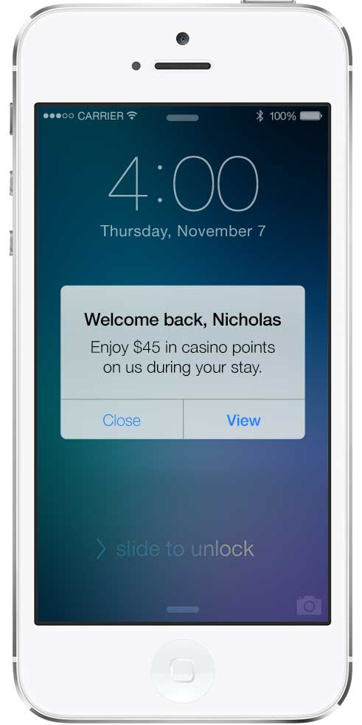
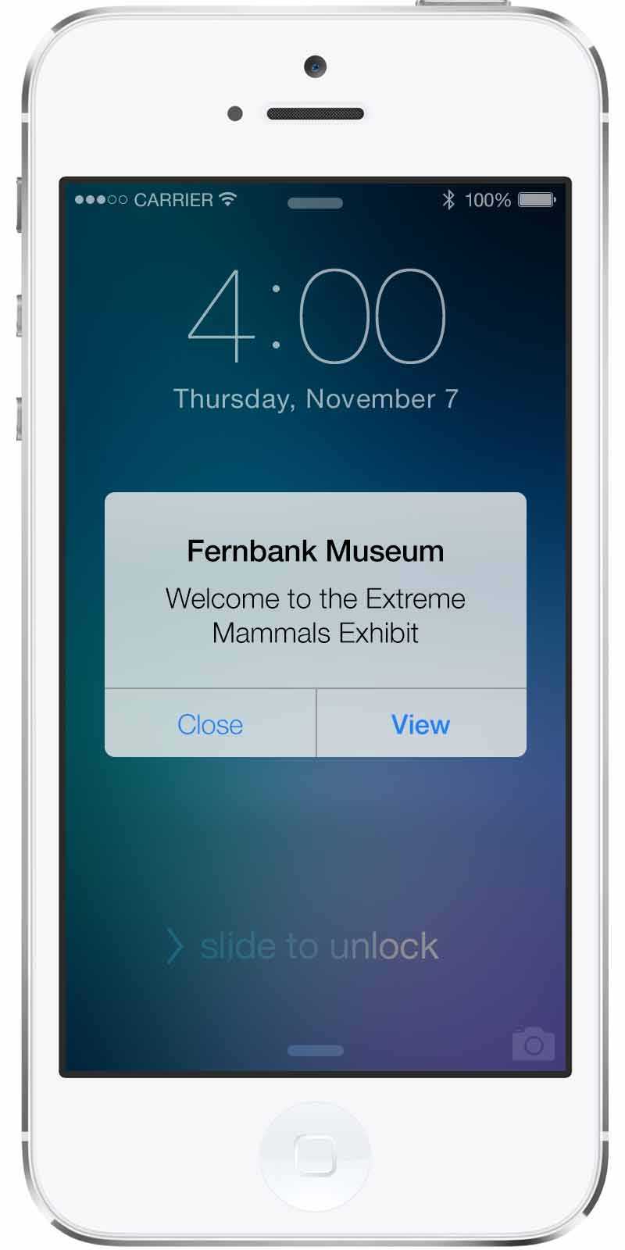
Нотификации

Slide 27
Управление

Slide 28
Гибкое управление
Облачная система
Мультивендорный подход
Central
Instant, Коммутаторы
Гостевой доступ, MDM
Visual RF, WIDS отчеты, Фильтрация приложений и контента
AirWave
Aruba & Другие вендоры
Visual RF, WIDS отчеты
Фильтрация приложений и контента
Notes:
Instant APs + Hospitality APs
Services, Management, Connectivity all in three separate slides.
Meridian is part of services
All with their software modules highlighted1. 100% of growth year over year… compare against Aerohive, Ubiquiti, Meraki, Ent WLAN, Aruba… customer wins + tech features
2. With central it becomes an unbeatable product…
3. Use cases
4. Single architecture slide

Slide 29
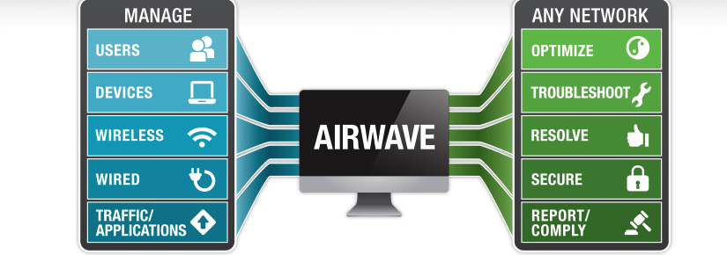
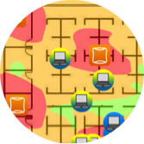



On-prem: AirWave
Мультивендорность
Отслеживание пользователя
VISUAL RF
Notes:
AirWave Management Software utilizes context to show the app and device experience on networks with Aruba, Cisco, HP and Motorola equipment. This is the only way IT departments can graduate to guaranteeing a mobile experience as opposed to just network uptime. This is exactly why some of the worlds largest Aruba, Moto, Cisco & HP networks run Aruba AirWave. As an example:
NYC Dept of Edu manages 80K Cisco APs with AirWave
HP enterprise runs corporate WLAN and Wired with AirWave
Staples uses AirWave to manage Moto APs
Google relies on AirWave for 8,500 Aruba APs at Starbucks locations

Slide 30



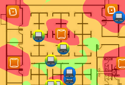
AirWave 8.0
AppRF 2.0
Кластеризация
Надежность
  Переключение <10мин без потерь
  Поддержка до 20,000 ТД
Мониторинг Lync и AppRF
HTML5
  Отчеты и мониторинг
Notes:
The AirWave 8.0 release will:
Extend support for managing up to 20,000 APs
Provide rich Lync dashboard and reporting while extending the tools for monitoring and managing other applications within AppRF
Cuts the failover time to under 10 minutes….with no data loss.
Moves from Java to HTML5 in order to enable administrators to access the management interface from a wider set of platforms including mobile devices such as tablets.

Slide 31


А вы готовы к
Notes:
Thank you for your time, Aruba hopes its technology and solutions, our ecosystem of partners can be of service to help customers address enterprise mobility needs and concerns in the workplace.

